Slide 1
Computing Visions 2025:
David Culler (CISE AC), Beth Mynatt (CCC), Limor Fix (CCC),
James Landay (CISE AC), Jennifer Rexford (CISE AC), and Ed Lazowska (CCC)
Maja Mataric (USC)

Slide 2
Genesis Vision 2025
Nov. 2012: AD Farnam Jahanian engaged CISE Advisory Council in a brainstorming around CISE 10-15 years out
Feb 2013 CISE AC Chairs for a Vision 2025 WG
  Culler, Landay (chairs), Fran Berman, Jaime Carbonell, Teresa Dahlberg, José Fortes, Juan Gilbert, Peter Lee, Stefan Savage, Bobby Schnabel
  3 meetings in preparation for a May 2013 breakout
    Brainstorming, Major Thrusts, NSF implications
May 2013 Breakout Session and Discussion
  Compelling experience led to a desire to engage the community more broadly
  => Joint CCC/AC committee to produce an integrated suite of workshops offering different perspectives on common question.

Slide 3
The May 2013 Tee up

Slide 4
NSF AC WG

Slide 5
WHY VISION 2025?
There is a sense in many different parts of the community that we are on the cusp of transformational changes that make looking out a decade from now very different than such exercises in the past
  Not just technological change, but societal change and individual change
  Need to get beyond our disciplinary and sub-disciplinary silos to grasp it fully
CCC/NSF CISE are brainstorming on this common question from several different perspectives in three partially overlapping workshops
Notes:
France Cordova (NSF Director): What are the other markets that are not democratized that may be by technology? Search engines impact this.

Slide 6
THREE WORKSHOPS
6
Interacting With the Computers All Around Us
When disruptive technology transformations change our interaction assumptions: how will these change interactions of people to computing, machine to machine, & people to people?
The New Making Renaissance: Programmable Matter and Things
When the decentralization of creation and mass delivery of software is achieved for many other constructive arts: 3D printing, synthetic biology, printable electronics, end-user programming, manufacturing, robotics, design, health, CAD/CAM, & intellectual property
Computing & the Smart World
When “smart everything” will trigger major transformation in societal services: health, education, transportation, & more
Some overlap among topics and participants in very different settings
Build comprehensive 2025 vision from the outcomes of the workshops
Notes:
Tom Kalil OSTP says:
In addition to ideas we are generating, but we need to know the:
What is status quo, what is the future? How to act?
Coherent relationship between ends and means.
What would it take to make it happen?
Ultimately instantiated in a document (so having words is useful)
what
the how
the who
the why
TO help the US government to help move these ideas forward

Slide 7
Computing Visions 2025:
Interacting with the Computers All Around Us
May 13, 2014
Limor Fix, Jennifer Rexford, Daniela Rus
WS Chairs
CCC/NSF sponsored workshop

Slide 8
Workshop Goals
  Develop visions and identify core technologies needed for the future of interaction among humans, computers, and the physical world:
    Assist people: Health, Education, Work, Family, Home,…
    Empower communities: Communicate, collaborate, organize for better sustainability, quality of life, …

Slide 9
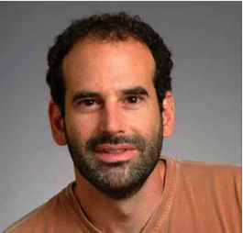
Participants
Session chairs: Andrew Senior (Google),
Vijay Kumar (UPenn), Seth Teller (MIT),
Maja Mataric (USC)
Around 50 participants: top universities, NSF, DARPA, Navy, Air Force, Army, IBM, Google
Seth Teller - dear friend and colleague

Slide 10
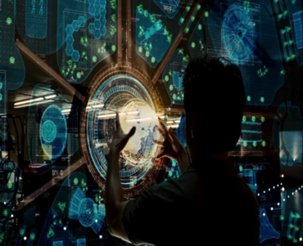
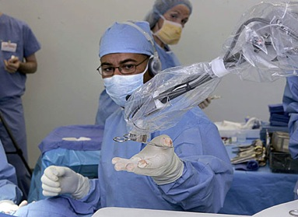
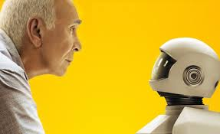
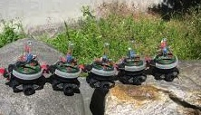
Intelligent Assistants
In 2025 we expect computing to dramatically improve the way it assist humans in three fundamental activities:
    Cognitive, Physical, Social
A vast variety of Networked Intelligent Assistants will exist
Assist humans to overcome challenges in education, health, elder-care, population growth, work, sustainability, and more

Slide 11
Conclusions
Many computational fundamentals come up in multiple application areas
  user understanding, natural interfaces, multi-modal/fusion, multi-party, connectivity, real time, vast amount of data, trust
Great benefits in cross-pollination within our rather vast computational research world (not only between computation and other areas/cross-disciplinary)

Slide 12
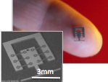
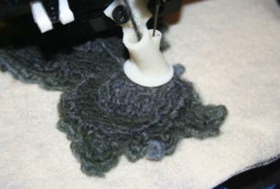
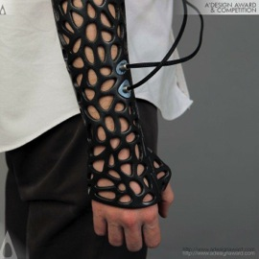


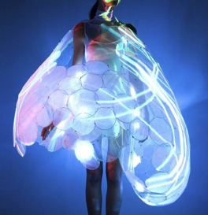
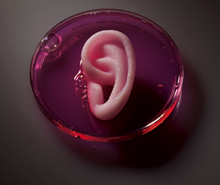
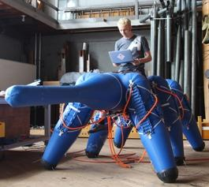
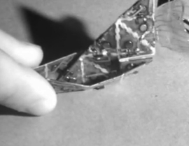
THE NEW MAKING RENAISSANCE
Programmable Matter and Things
NSF / CRA Vision 2025 Vision Workshop
held 2-4 June 2014
Eric Paulos, UC Berkeley David Culler, UC Berkeley
Prabal Dutta, University of Michigan James Landay, Cornell Tech / Stanford

Slide 13
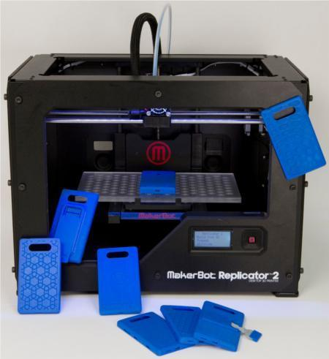


NEW MAKING RENAISSANCE: A REVOLUTION?
+
+
DIGITAL FABRICATION
FLEXIBLE ELECTRONICS
UBIQUITOUS
PROGRAMMING
This new renaissance, underpinned by “maker movement”, may change the way that most items are designed, manufactured, and delivered.
Confluence of 3 major trends:
cheap and fast creation of matter in new forms (e.g., 3D printing)
on-demand electronics
programmable intelligence in every object
The creativity & change unleashed could change how society operates: return to craftsmanship with precision and the ability to mass customize/produce.
Notes:
NEW IMAGES HERE ***

Slide 14
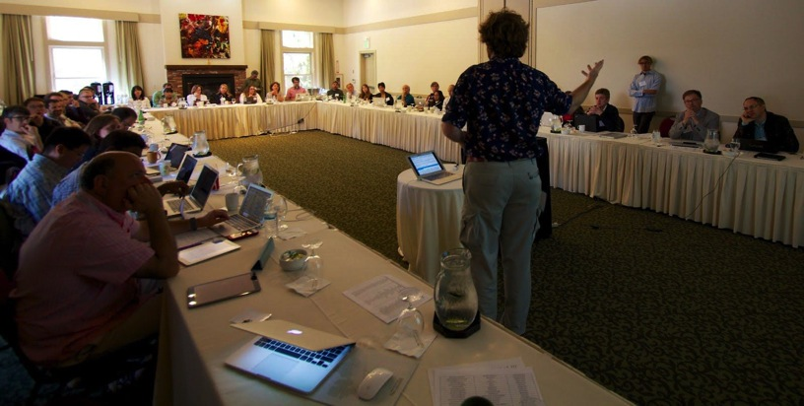
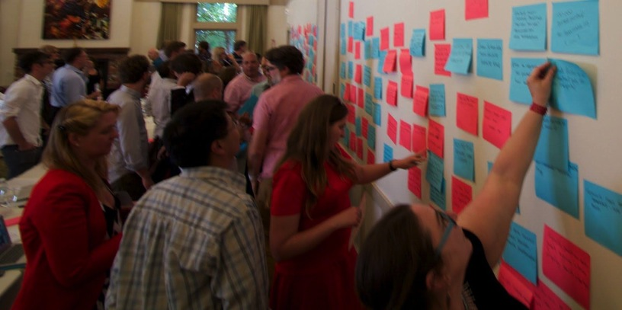
46 PARTICIPANTS • 2 DAYS • 3 KEYNOTES
WOMEN & MEN REPRESENTING
Academia
Industry
Entrepreneurs
Technology Leaders
Scientists
Sociologists
Designers
Artists
Government
NSF / CRA
Across a range of disciplines
Notes:
The workshop brought together experts in 3D printing, synthetic biology, end-user programming, printable electronics, manufacturing, robotics, design, health, & CAD/CAM.
Over ⅓ of the participants were women.

Slide 15
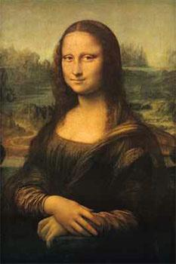
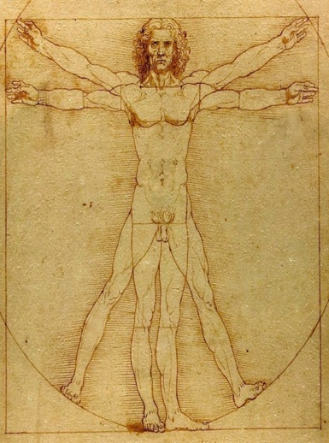
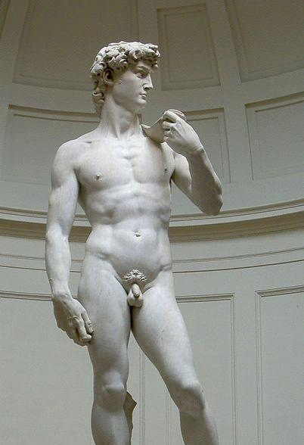

WHY RENAISSANCE?
Drawing inspiration from the historical rebirth movement across
ART
+
SCIENCE
+
CULTURE

Slide 16
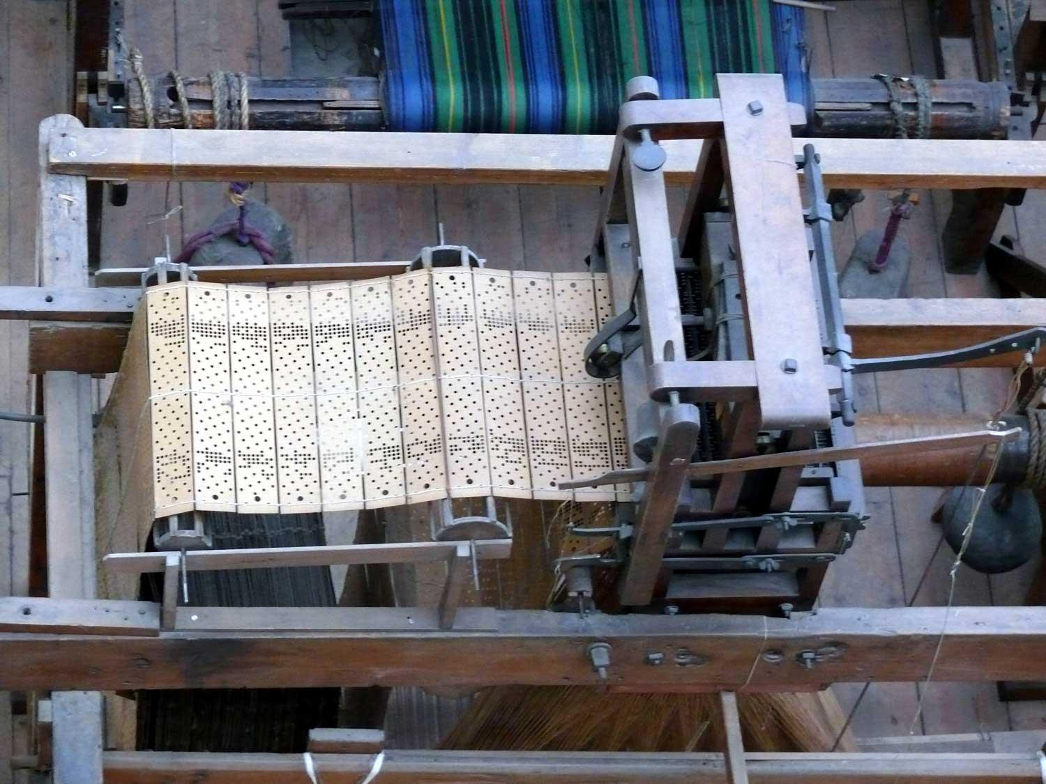
SOCIETY HAS BEEN HERE BEFORE
EARLY 1800’S MECHANICAL PROGRAMMING REVOLUTIONIZES HOW THINGS ARE MADE
FAMILIAR ISSUES RESURFACE:
SAFETY, LIABILITY, STRUCTURE OF LABOR
Notes:
Jacquard Loom (1801)

Slide 17
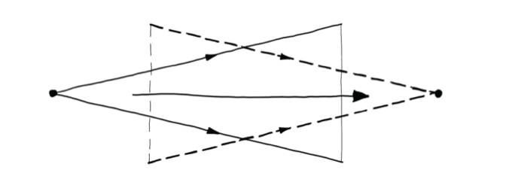
WORKSHOP FORMAT
200+
Headline
Ideas
6 Headline
Breakouts
6 Cross-cutting
Topics
46 People
2 min lighting talks in one deck
6 Theme
Breakouts

Slide 18
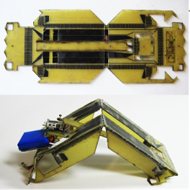
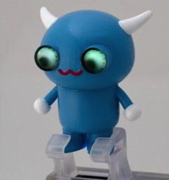
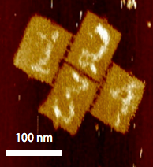

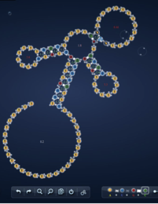
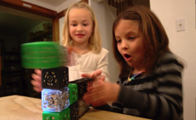
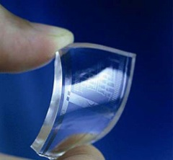
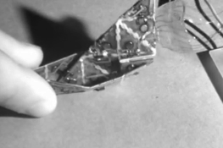
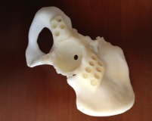
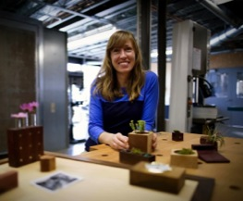
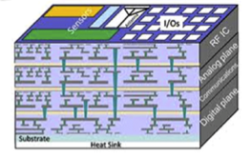
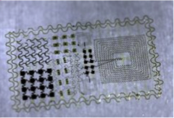
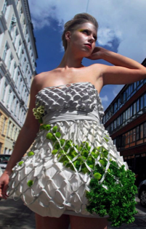
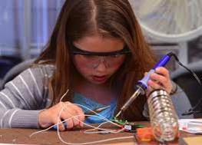
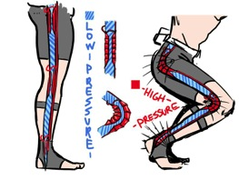
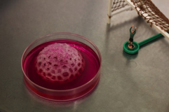
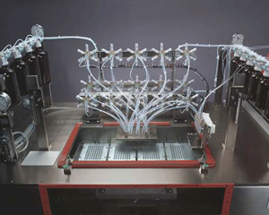
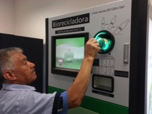
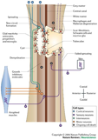
LIGHTNING INTRODUCTIONS
2 MINUTES
2 SLIDES
Who are you?
What do you do?
What is the primary
Opportunity
Challenge
Open Question
in next 10-20 years

Slide 19
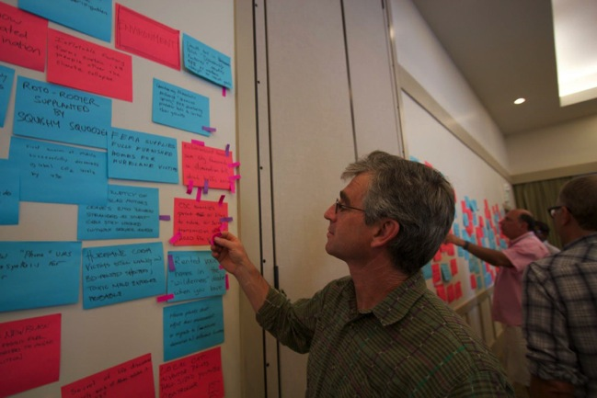
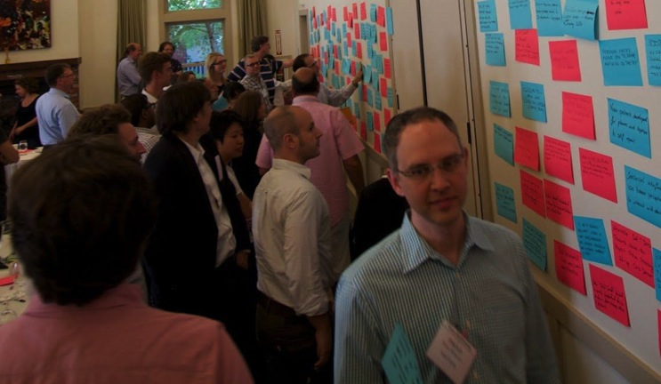
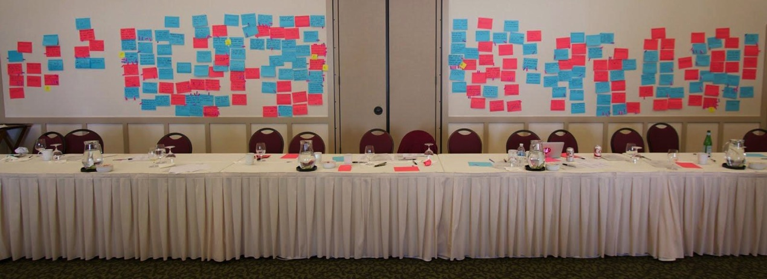
FUTURE HEADLINES … 15-20 YEARS OUT

Slide 20
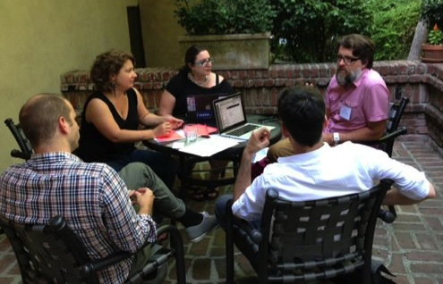
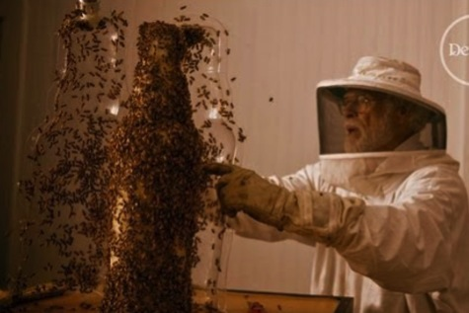
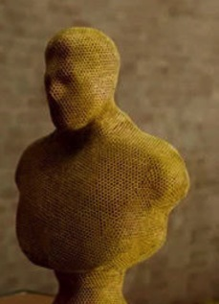
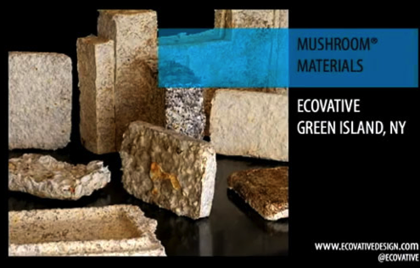
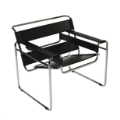

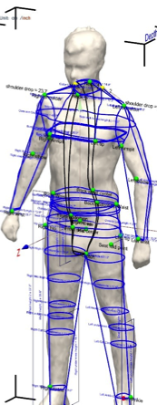
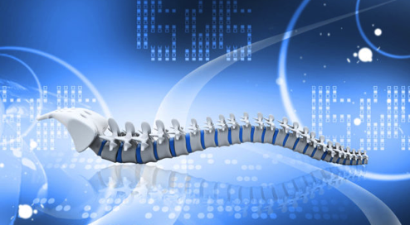
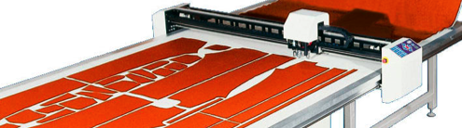
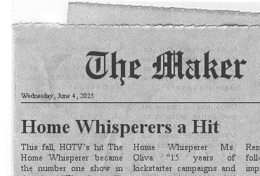



HEADLINE BREAKOUT GROUPS
TOP HEADLINE TOPICS
Robot Termite Builders
Genetic Algorithm Wins Furniture Competition
Bespoke Digital Tailors
Spinal Column Grows with Child
Internet of Things Fatigue
Bioluminescent Trees
Notes:
FIX HEADLINES TO BE EXACT

Slide 21



EMERGING THEMES BREAKOUT GROUPS
Interplay of Science and Design
Education and Training of Makers
Design Tools
Empowering Small Business
Health and Bio
Sustainable Infrastructure Meets Making

Slide 22






KEY CROSSCUTTING TOPICS
Science, Education & Design are Intertwined
come at solutions differently, but all are required for innovation
just-in-time, lifelong learning & project-based learning key
where does higher ed fit in this?
Design Tools are essential to accelerating innovation & productivity
tools must work across electronics, physical form & software
need tools to promote creativity
need tools to help leverage new materials
http://bouncingideas.wordpress.com/2011/11/12/design-engineering-science-their-differences-through-the-lens-of-biomimicry/

Slide 23



KEY CROSSCUTTING TOPICS
Micro-manufacturing that scales from small to large to empower small businesses
Sustainable infrastructure is necessary
maker outputs that are recyclable & reusable
how to augment the natural world?
Health/Bio applications need modular devices
interface w/ bio parts
“bio foundries”
abstraction barriers allow designers to focus on their area of expertise
shape changing implants

Slide 24
CALL TO ACTION
Success of New Making Renaissance requires
Interdisciplinary efforts across practitioners, materials, techniques
Demand educational models that promote interdisciplinary thinking and problem solving – a genuine degree in “making”
Foster research that explores across materials and methods
(bio | mechanical | electrical | computational) – hybrid making
Develop an open a political regulatory committee to advise government and public on legal and ethical issues
Broaden funding model to support long and short term efforts focused on new making materials and techniques
Capture the energy and passion of this movement by involving local communities in problem solving and innovation efforts

Slide 25

THANK YOU
SPECIAL THANKS
NSF CISE AC / CCC: David Culler, James Landay, and Beth Mynatt
CRA: Ann Drobins and Helen Vassaly

Slide 26
Computing Visions 2025: an initial synthesis

Slide 27
Foundations
Sensing, recognition and modeling of the external world; fusion
Self organizing and self-adapting networked objects
Real-time systems; reliability
Local and cloud data and computation; security
Human computer interaction, natural interfaces, long-term adaptive systems

Slide 28


USE Inspired research
Assistive technology to Extra-Ordinary human capabilities
Locally fabricated objects with deep contextual understanding
RASP: Robots, Agents, Sensors and People
Shape our physical surroundings
What is the app store for the Internet of Things?
Notes:
How to hack your own HVAC
Blending of human-robot interaction and human-object interaction. Described the “aware home” as a robot turned inside out.

Slide 29

Computing Community
CS Education for computing in the physical world
Multi-disciplinary research
  Design community
  Material science
  Deep collaborations about use context
Big Shot: The Camera for Education
Shree Nayer, Columbia University

Slide 30

National priorities
Aging in place;
health caretakers
Education and employment
Environmental sustainability
Robot caregiver
Charlie Kemp, Georgia Tech

Slide 31
Open for discussion
Can we see the cusp of a new renaissance?
Are these times of great change and opportunity, even reaching a crossroads for the field?
How do we prepare our research community?
  How do we train our students?
How does our research community help address larger societal needs and opportunities?
What are the implications of technical tradeoffs (e.g. reliance on cloud computing)?

Slide 32
CCC discussion
Ideas for future 2025 workshops.
On the drawing board “Data analytics for a Smart World”
White papers akin to Big Data papers?
How to connect to the larger computing community?
How to connect outside the larger computing community?

Slide 33
BACKUP SLIDES

Slide 34


Cognitive Intelligent
Assistants
In recent years, “digital assistant”, like Siri,
Google Now and Cortana
In the future, we expect such assistants to grow dramatically in their capabilities: tutors/education, decision making, health monitoring/analysis,…
Capabilities: natural interactions, real-time analysis, access to the cloud and vast amount of data
Core technologies: sensors, recognition (speech, vision, environment), end-user modeling (user preferences, user special needs), fusion

Slide 35
Physical Intelligent
Assistants
In recent years, co-robots for assisting
humans in applications ranging from manufacturing to surgery
In the future, we expect human-robot
teams act seamlessly with natural interfaces, anticipating and complementing each other
Capabilities: physical augmentation, natural interaction/clarification, high-level (functional) specifications, trust
Core technologies: 3d perception, manipulation, interfaces, modeling,
planning/transparency

Slide 36
Social Intelligent Assistants
In recent years, “behavior change technologies” have emerged, like the Fitbit, Jawbone, etc. to track, report, and nudge the user's state
In the future, we expect such assistants to be personalized, interactive and adaptive to relate to each user's evolving needs.
Capabilities: interpret the user's health and emotional state, understand ongoing and intended activity, provide advice, coaching, and motivation, trust
Core technologies: integration of multi-modal personal data, working with small-n single-person intermittent data, adaptation over the long timescale from noisy data, personality, motivation

Slide 37
Networked Intelligent
Assistants
In recent years, dramatic grows of #devices connected to the internet
In the future, we expect intelligent assistants
of many shapes and capabilities will be part
of large smart networked systems with
Robots, Agents Sensors and People (RASP)
Capabilities: swarms, interactions between networked people and machines
Core technologies: local and cloud data and computation, autonomous machines, reliability, self organizing, self-adapting architectures, real time systems

Slide 38
How come it’s not my area X ????

Slide 39
VISION 2025 WORKSHOP SUITE
Computing &
the Smart World
The New Making
Renaissance
Interacting With the Computers All Around Us

Slide 40



GOALS
ARTIFACTS FOR POLICY MAKERS
COMMUNITY & DIRECTION

Slide 41
AREA CLUSTERS
HEALTH
FOOD
BUSINESS
SECURITY
POLICY
CRIME
ENVIRONMENT
EDUCATION
SUPER HUMANS
ROBOTS
CYBORG / BIO
FASHION
ART
FAIL

Slide 42






FUTURE HEADLINES … 15-20 YEARS OUT
200+ IDEAS
6 BREAKOUT GROUPS DISCUSSED TOP IDEAS WITH FOCUS ON:
RESEARCH ENABLERS
TECH INNOVATIONS
NEW BUSINESS MODELS
EMERGING PRODUCTS
SOCIAL IMPACTS
POLICY CHANGES
LEGAL DEVELOPMENTS
OPPORTUNITIES

