Slide 1
Two Models of Apprenticeship: Clinic and REU
Ran Libeskind-Hadas
Department of Computer Science
Harvey Mudd College

Slide 2
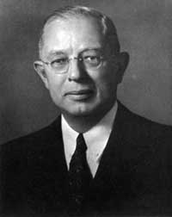
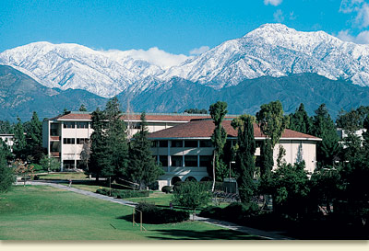
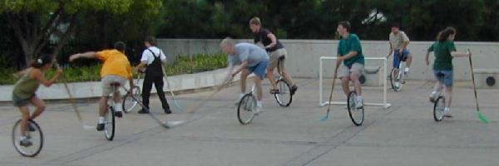
Our Name is Mudd…
Harvey Mudd
Harvey Mudd sounds like…

Slide 3
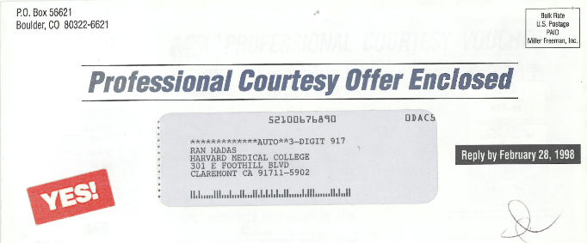
Harvey Mudd College

Slide 4
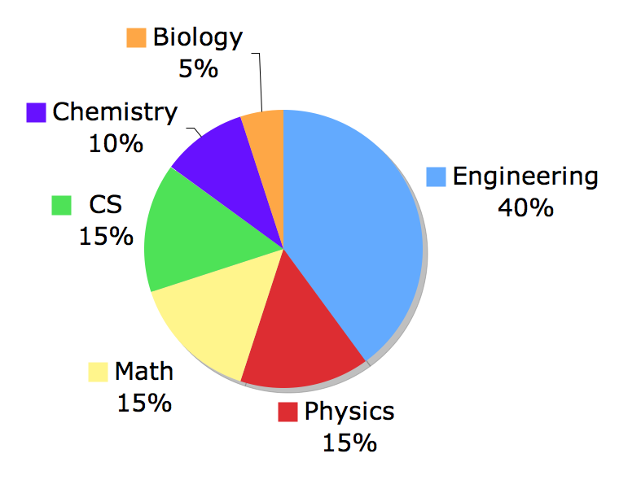
Harvey Mudd
Undergraduate only (4-year B.S.)
Approximately 800 students total
200 first-year students
1.5 years of “common core”
Students choose major at end of second year
Majors
chosen
at HMC…

Slide 5
A few observations…
Many/most undergraduate students don’t understand what CS research is all about
If we want to broaden and diversify the “pipeline” into CS research, we need to…
Explain what CS research is about
Explain why CS research is exciting
Provide more undergraduate research opportunities

Slide 6
Two programs
Clinic Program: Applied research during the year
NSF REU Site: Summer research

Slide 7
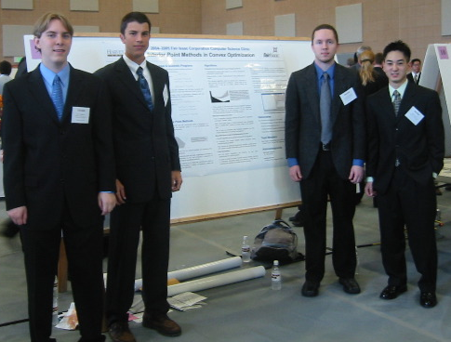
The “Clinic” Program
Four students (typically seniors)
Two semesters (1 of 5 classes)
Concept-to-Product
Faculty supervisor
Sponsor liaison
$50K fee

Slide 8
Unlike…
Unlike internships
Project vetted by faculty
Faculty supervision
Work done on campus
Unlike research
Always a group project
Sponsor owns IP
Publications secondary to deployment

Slide 9
Benefits
For students…
Work on a problem that is likely to be deployed
Experience with a large-scale project
Planning, teamwork, leadership
Satisfaction of completing something big and real
For sponsor…
Value
Recruiting

Slide 10
Examples of Projects
SPARQLy: An RDF Store for Regularly Structured Data (Dreamworks Animation)
Building a Replicated Transaction Log Library (LinkedIn)
Visualizing Proof Search (FICO)
Computer Simulation of the GPS Ground Network (Boeing)

Slide 11
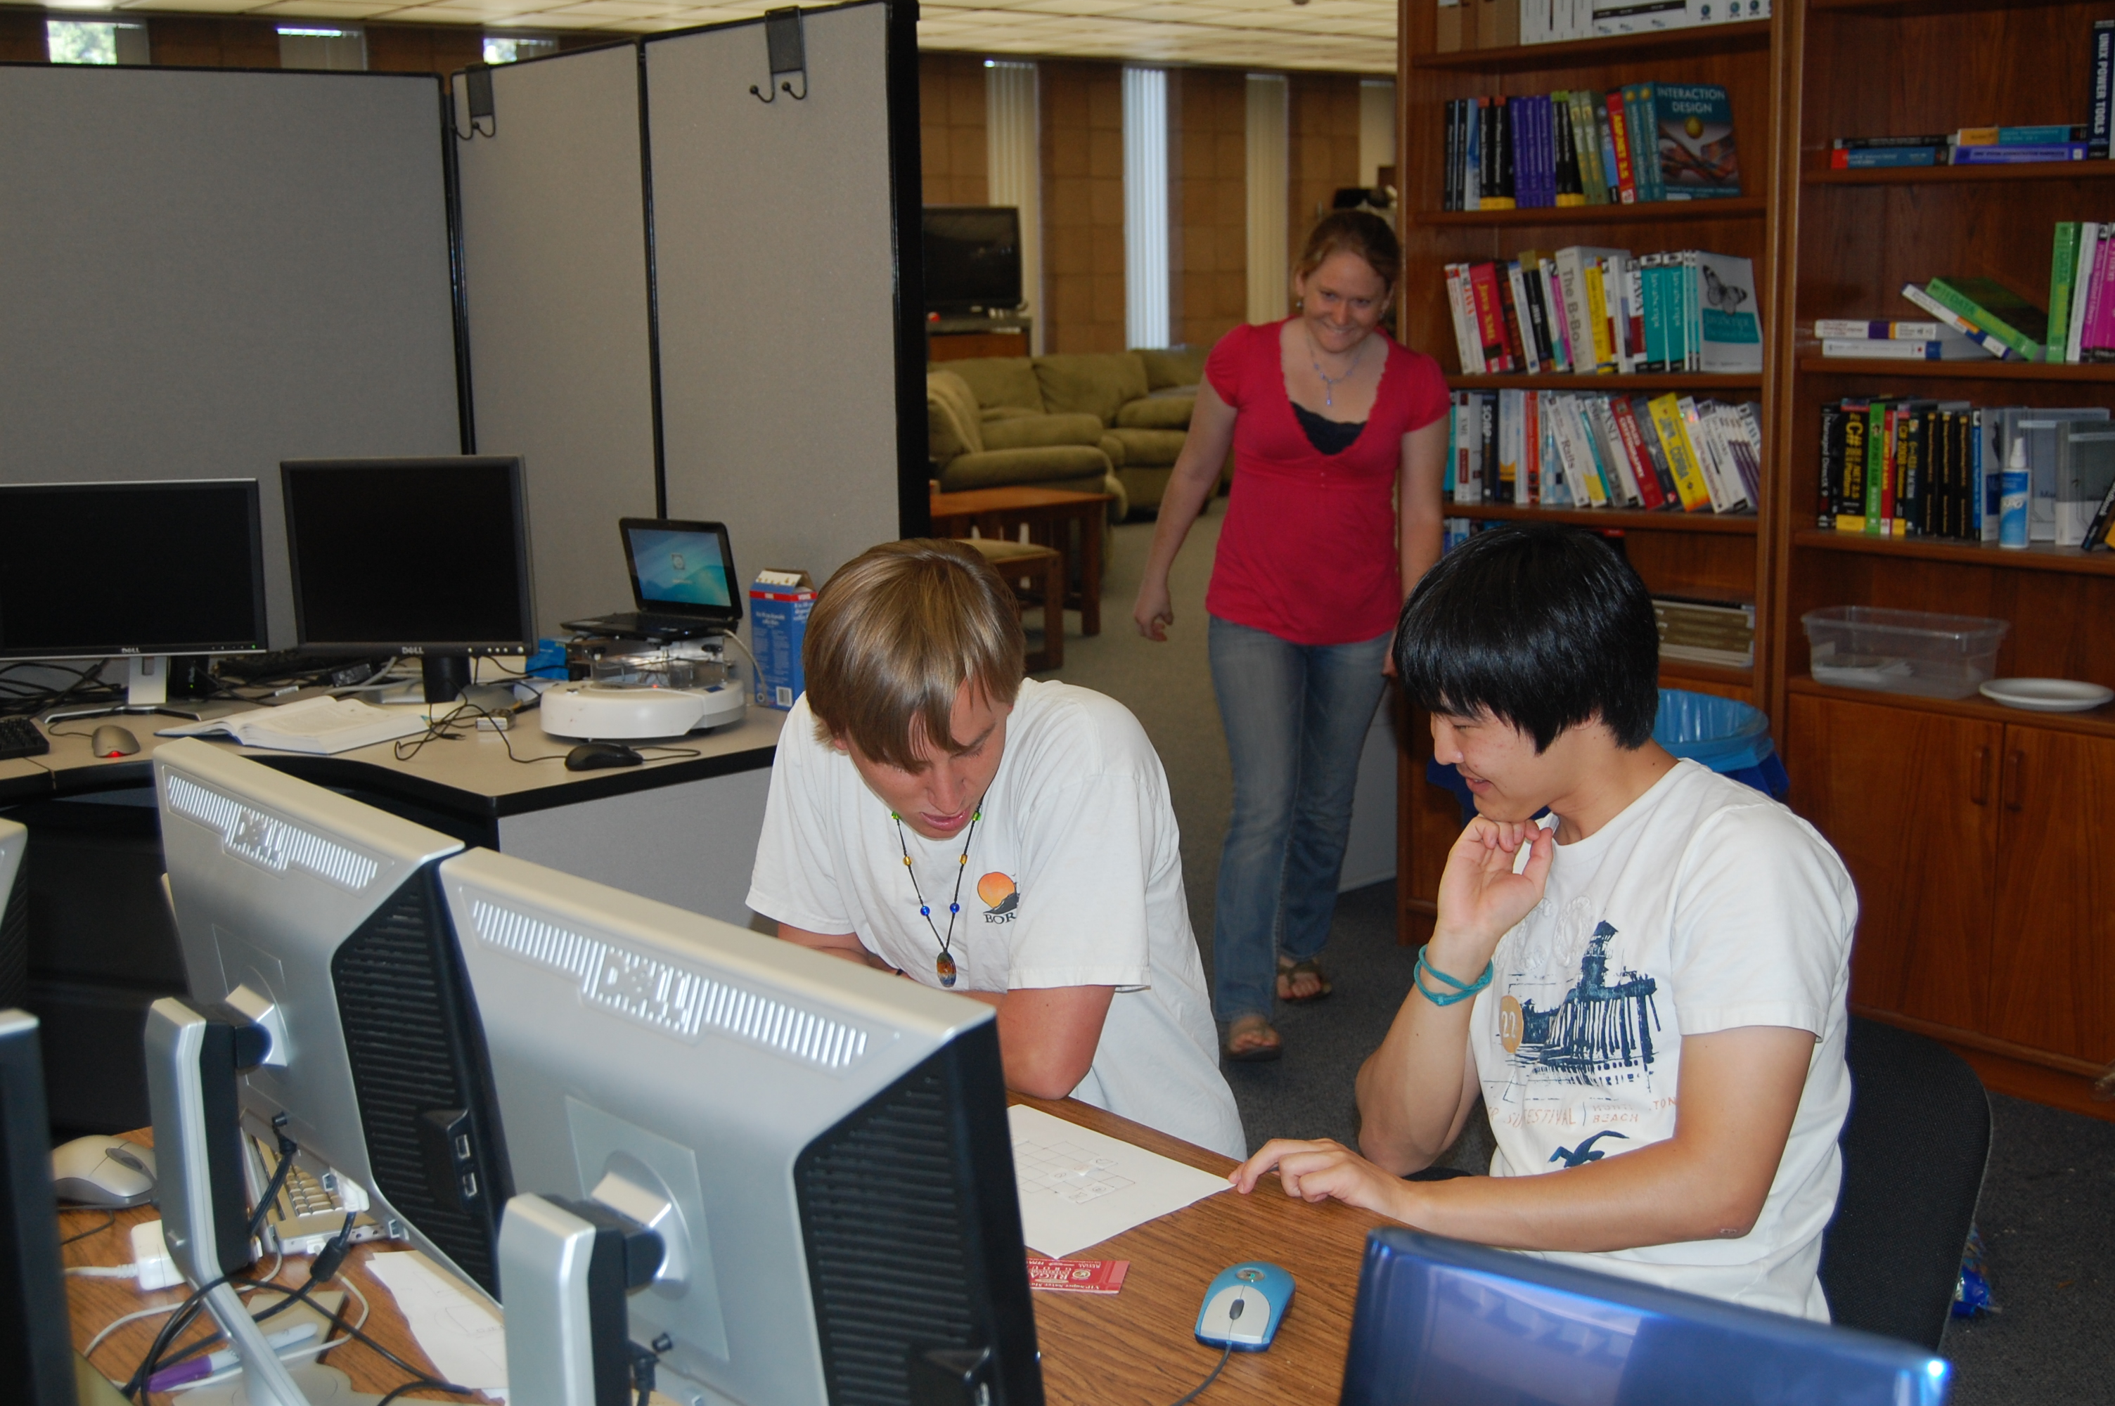
NSF REU Site
10 undergraduate students per summer
5 from home institution, 5 from other schools
REU provides $ for stipends, food, housing, travel
Narrow or broad research scope
Currently 60 sites nationwide

Slide 12
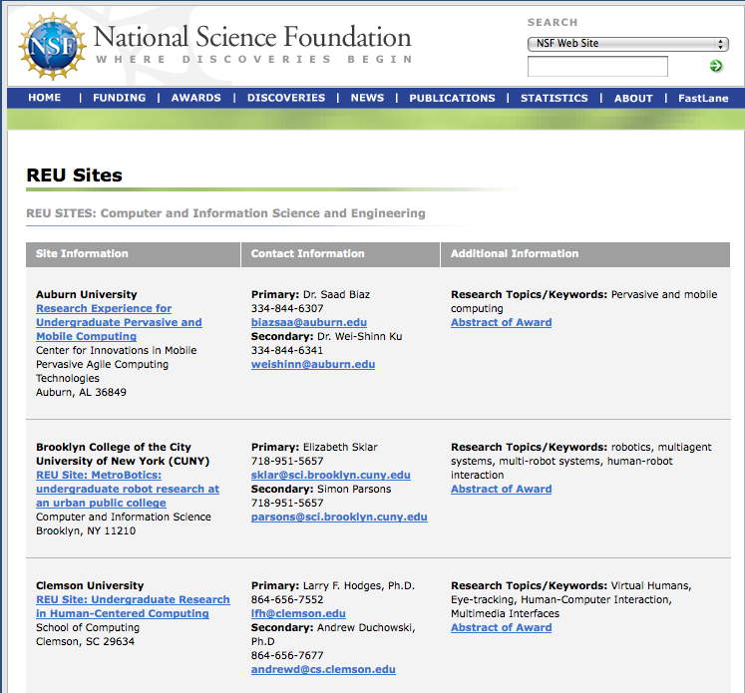

Slide 13
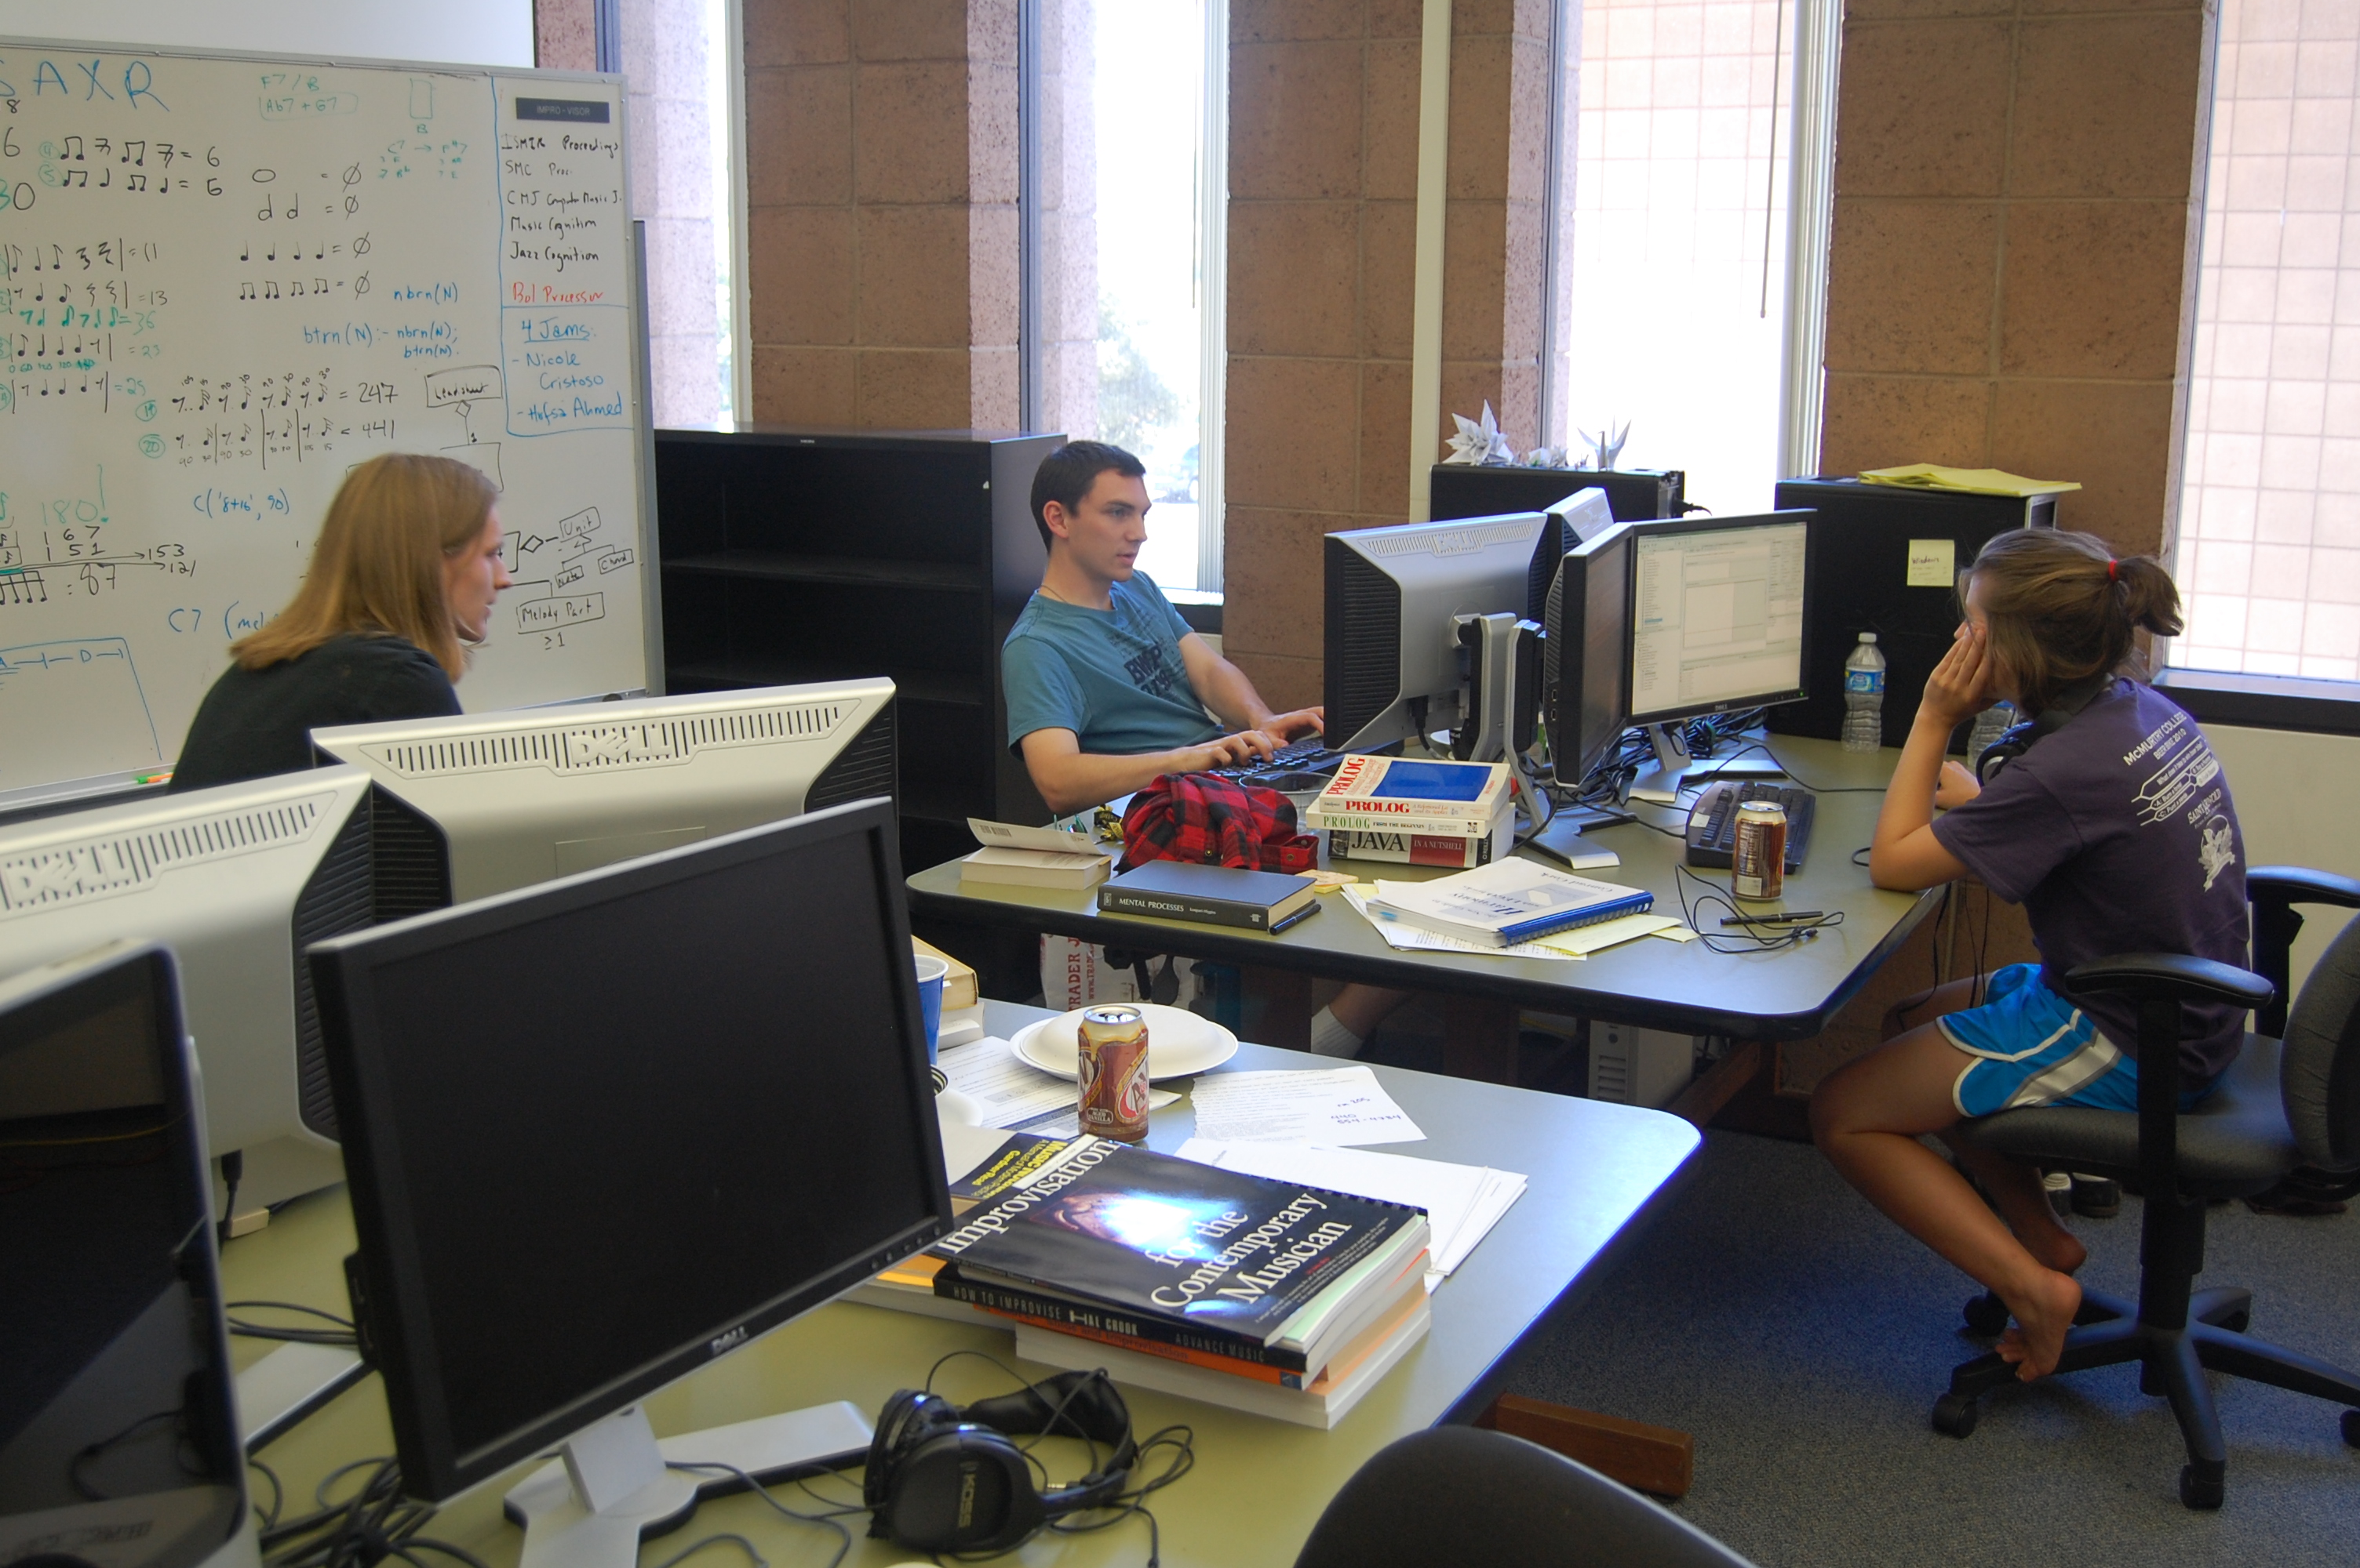
HMC REU
PI oversees program
Four faculty mentors and projects
Garbage collection
Computer vision for robotics
AI techniques for teaching jazz improv
Computational biology
Enrichment
Fun topics lectures
Research careers panel
Applying to grad school

Slide 14
Time commitment
Common application and assessment instruments
Administrator spends ~5 hours/week
Faculty time
Admissions
Logistics (first time!)
Research supervision

Slide 15
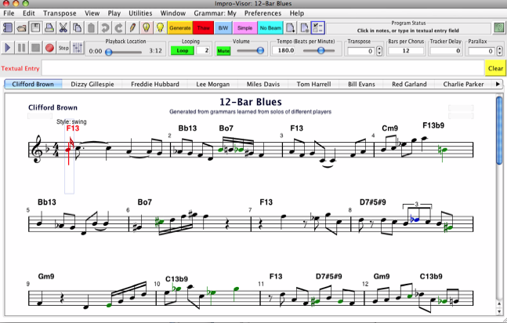
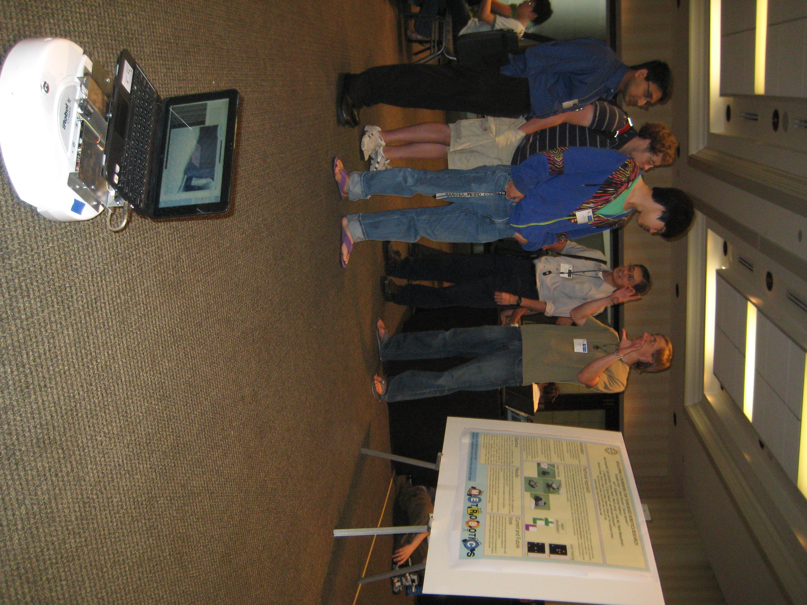
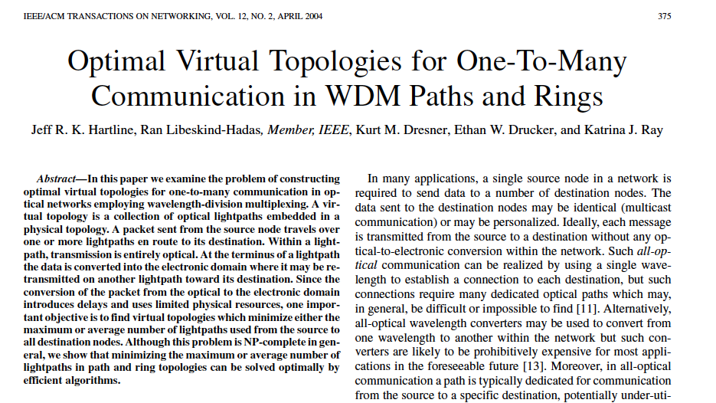
Outcomes

Slide 16
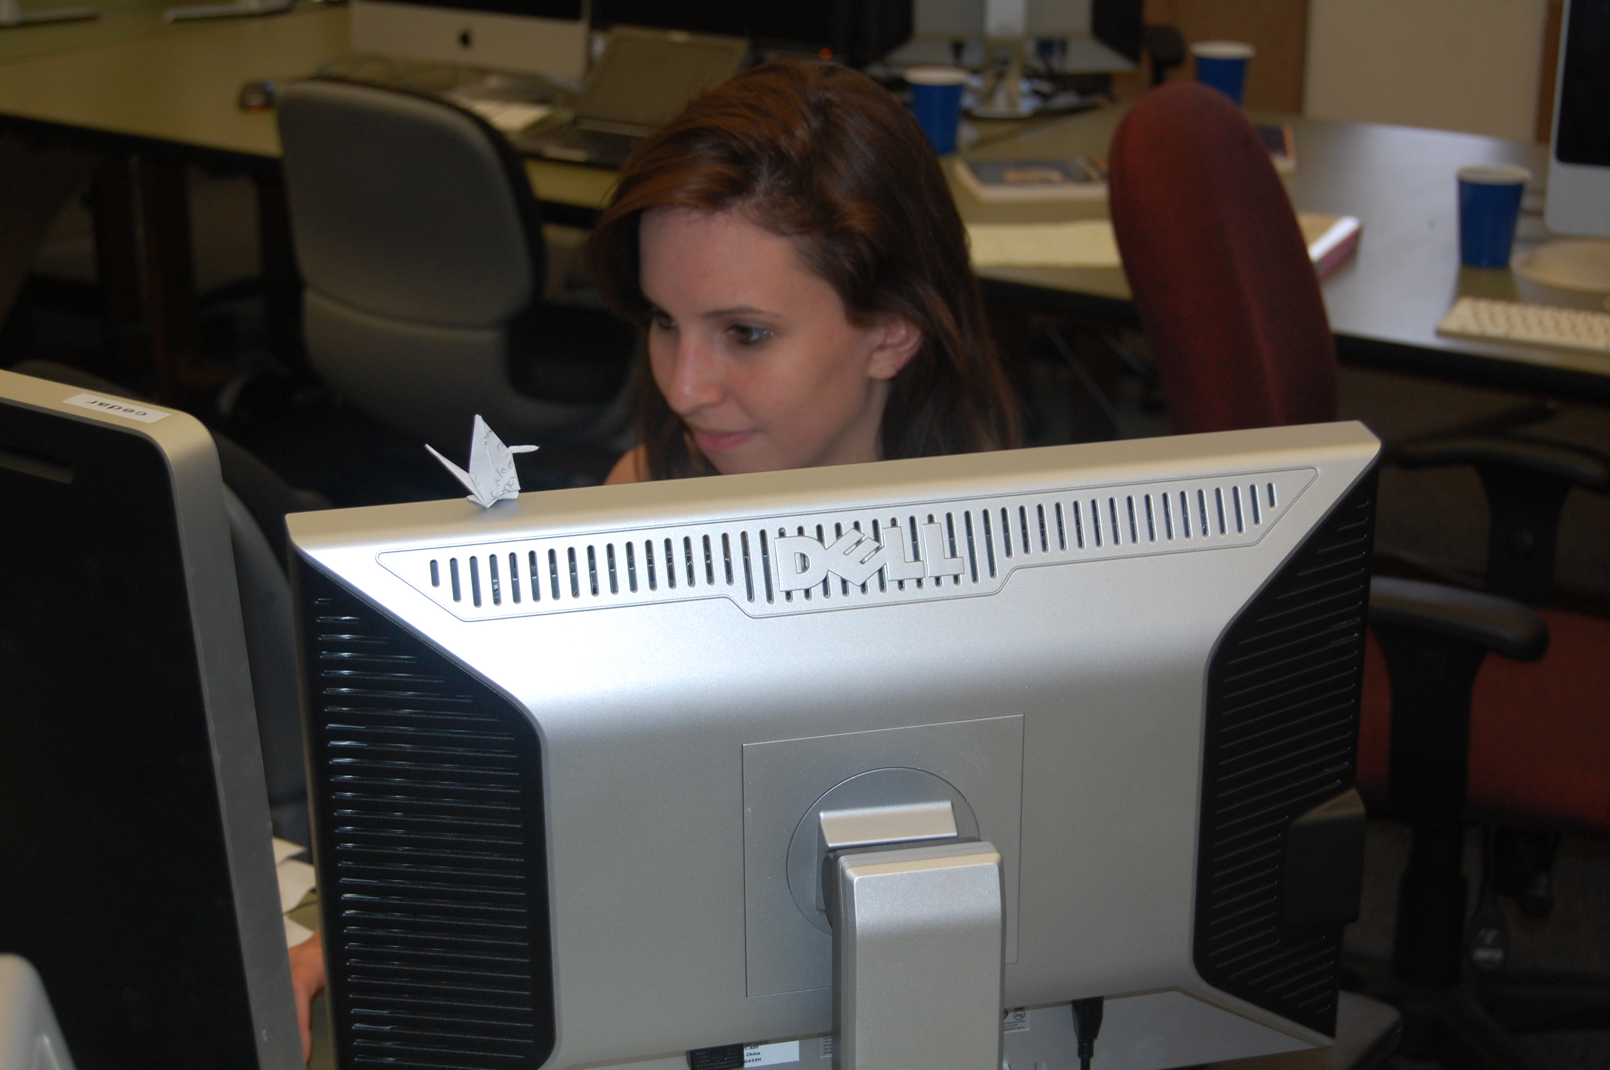
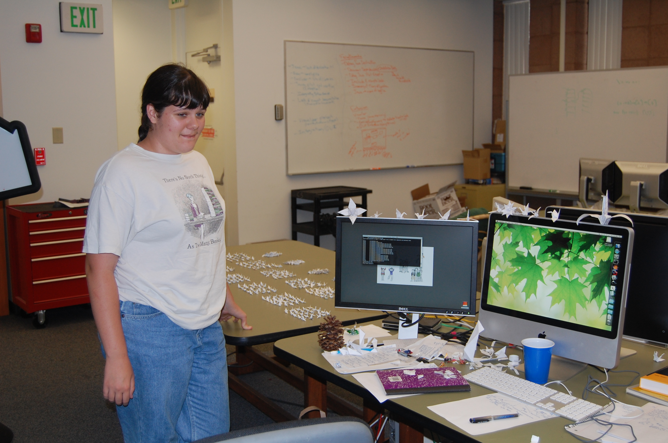
Before and After the REU
Upon entry…
Almost all REU students indicate curiosity about research
Almost all are unsure if they will pursue a research career
A few years laters… over 90% continue on to Ph.D. programs

Slide 17
Questions and Comments…

