Slide 1
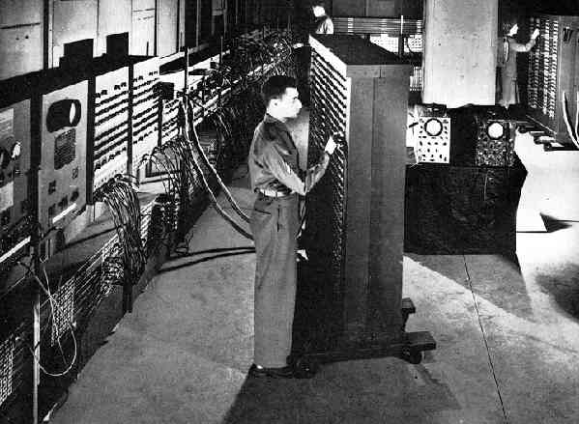
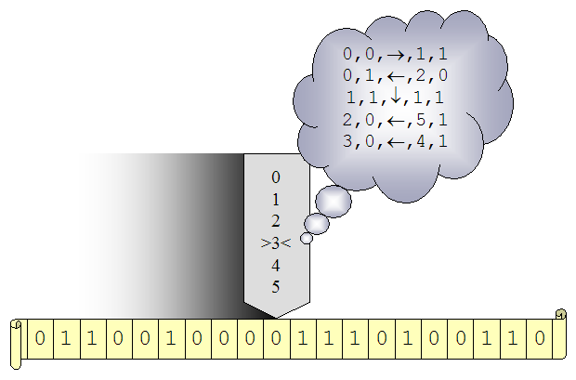
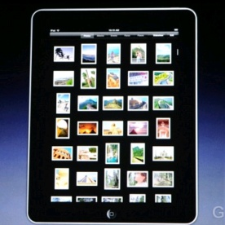
Computer and Information Science and Engineering (CISE)
Jeannette M. Wing Assistant Director
iPad
…
1935
1946
Credit: Apple, Inc.
2008
2010
The Computing (R)Evolution
Notes:
1

Slide 2
NSF

Slide 4
FY08-FY11 NSF/CISE Funding
FY08 NSF $6.13B
CISE Appropriate was $535 million, 1.5% increase from FY07
FY09 NSF $6.49B, 7% over FY08
CISE Appropriate was $574 million, 7.1% over FY08.
ARRA (“stimulus”) NSF: $3 billion
CISE ARRA: $235 million
FY10 NSF Request $7.05B, 8.5% over FY09
CISE Appropriate is $618.83 million, 7.9% over FY09 (omnibus).
FY11 NSF Request $7.4B, 8.5% over FY09
CISE Request is $684.51 million, 10.6% over FY10

Slide 5
CISE and NSF Budgets FY08-FY10 Appropriate, FY11 Request

Slide 6
NSF FY 2011 Request to Congress (Dollars in Millions)
Request over FY 2010 Est.
FY 2011 Amount Percent
BIO $ 767.81 $ 53.27 7.5%
CISE $ 684.51 $ 65.68 10.6%
ENG (Excl SBIR) $ 682.81 $ 64.65 10.5%
GEO $ 955.29 $ 65.65 7.4%
MPS $1,409.91 $ 58.07 4.3%
SBE $ 268.79 $ 13.54 5.3%
OCI $ 228.07 $ 13.79 6.4%
NSF Total $7,424.40 $551.89 8.0%

Slide 7
CISE-specific NSF-wide Investments

Slide 8
CDI: Cyber-Enabled Discovery and Innovation
Paradigm shift
Not just computing’s metal tools (transistors and wires) but also our mental tools (abstractions and methods)
It’s about partnerships and transformative research.
To innovate in/innovatively use computational thinking; and
To advance more than one science/engineering discipline.
Investments by all directorates and offices
FY08: $48M, 1800 Letters of Intent, 1300 Preliminary Proposals, 200 Full Proposals, 36 Awards
FY09: $63M+, 830 Preliminary Proposals, 283 Full Proposals, 53+ Awards
FY11 Request: $105.48M total, $50.00M CISE
Computational Thinking for Science and Engineering
Notes:
~650 Data to Knowledge, 500 Understanding Complexity, < 200 Virtual Organizations
90 PDs (~35 from CISE) and 6 (4 from CISE) admin staff across the agency helped

Slide 9
Range of Disciplines in CDI Awards
Aerospace engineering
Astrophysics and cosmology
Atmospheric sciences
Biochemistry
Biomaterials
Biophysics
Chemical engineering
Civil engineering
Communications science and engineering
Computer science
Cosmology
Ecosystems
Genomics
Geosciences
Linguistics
Materials engineering
Mathematics
Mechanical engineering
Molecular biology
Nanocomputing
Neuroscience
Proteomics
Robotics
Social sciences
Statistics
Statistical physics
Sustainability
…
… advances via Computational Thinking

Slide 10
Science and Engineering Beyond Moore’s Law
Three directorates: CISE, ENG, MPS, OCI
All investing in core science, engineering, and technology
Multi-core, many-core, massively parallel
Programming models, languages, tools
New, emerging substrates
Nanocomputing
Bio-inspired computing
Quantum computing
FY11 Request: $70.18M total, $15.0M CISE

Slide 11
CISE

Slide 12
Core and Cross-Cutting Programs
CCF
CNS
IIS
Core
Core
Core
Algorithmic F’ns
Communications & Information F’ns
Software & Hardware F’ns
Computer Systems
Network Systems
Infrastructure
Education & Workforce
Human-Centered
Information Integra- tion & Informatics
Robust Intelligence
Cross-Cutting
Cyber-Physical Systems
Data-intensive Computing
Network Science and Engineering
Trustworthy Computing
Plus many many other programs with other NSF directorates and other agencies
Notes:
Small December up to $500,000
Medium October FY09 August FY10 $500,001 up to $1,200,000
Large December $1,200,000 up to $300,000,000

Slide 13
Expeditions
Bold, creative, visionary, high-risk ideas
Whole >> Σ part _{i}
Solicitation is deliberately underconstrained
Tell us what YOU want to do!
Response to community
Loss of ITR Large, DARPA changes, support for high-risk research, large experimental systems research, etc.
~ 3 awards, each at $10M for 5 year
FY08 122 LOI, 75 prelim, 20 final, 7 reverse site visits, 4 awards
FY09 48 prelim, 20 final, 7 reverse site visits, 3 awards
FY10 23 prelim
i
What does this mean? What should we do about it?
Notes:
$10M for five year ($2M/year)

Slide 14
FY08-FY09 Awards
FY08 Awards
Computational Sustainability
Gomes, Cornell, Bowdoin College, the Conservation Fund, Howard University, Oregon State University and the Pacific Northwest National Laboratory
Intractability
Arora, Princeton, Rutgers, NYU, Inst for Adv. Studies
Molecular Programming
Winfrey, Cal Tech, UW
Open Programmable Mobile Internet
McKeown, Stanford
FY09 Awards
Customized Computing Technology
Cong, UCLA
Modeling Tools for Disease and Complex Systems
Clarke, CMU, NYU, Cornell, SUNY Stony Brook, University of Maryland
Robotic Bees
Wood, Harvard

Slide 15
Cyber-Physical Systems

Slide 16
Smart Cars
A BMW is “now actually a network of computers”
[R. Achatz, Seimens, Economist Oct 11, 2007]
Credit: PaulStamatiou.com
Cars drive themselves
Lampson’s Grand Challenge:
Reduce highway traffic deaths to zero.
[Butler Lampson, Getting Computers to Understand, Microsoft, J. ACM 50, 1 (Jan. 2003), pp 70-72.]
Smart parking

Slide 17
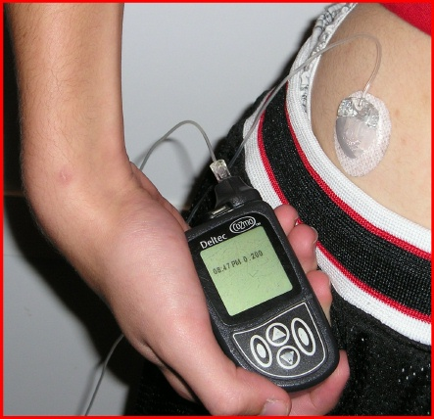
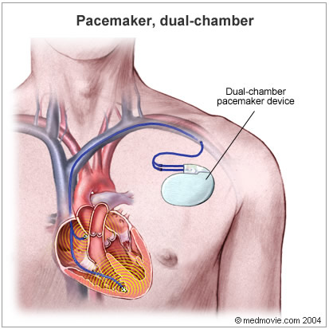
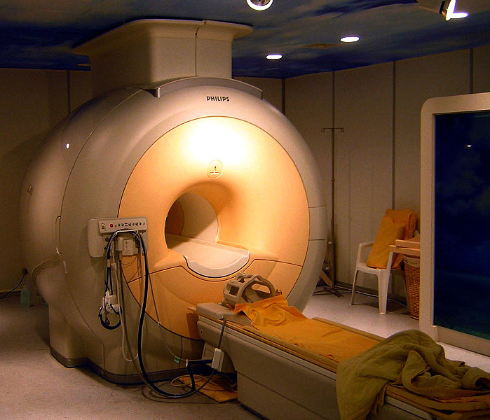
Embedded Medical Devices
infusion pump
pacemaker
scanner

Slide 18
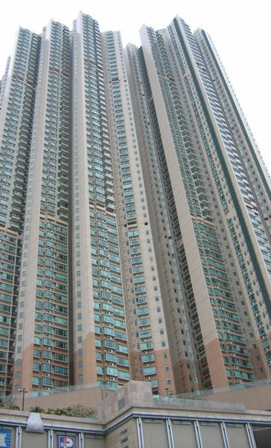
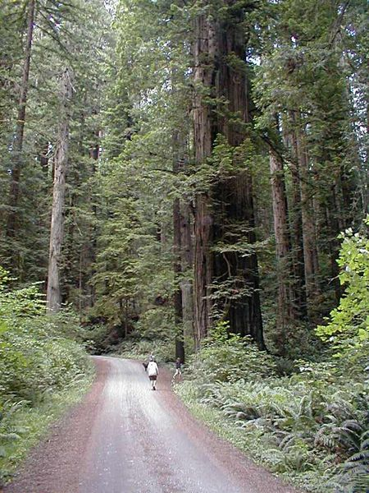
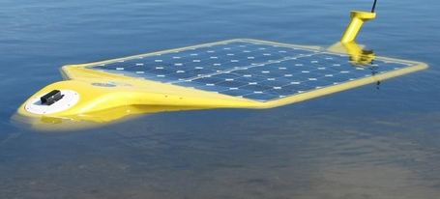
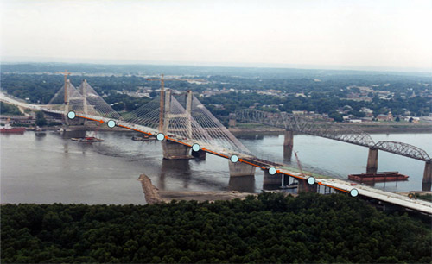
Sensors Everywhere
Credit: Arthur Sanderson at RPI
Hudson River Valley
Sonoma Redwood Forest
Kindly donated by Stewart Johnston
smart buildings
Credit: MO Dept. of Transportation
smart bridges

Slide 19
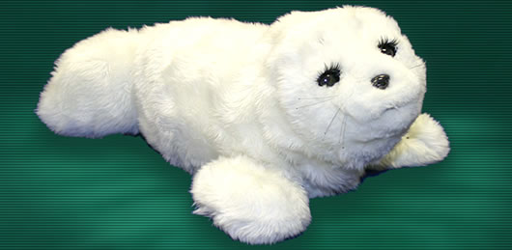
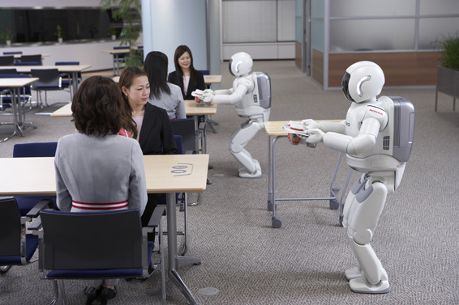
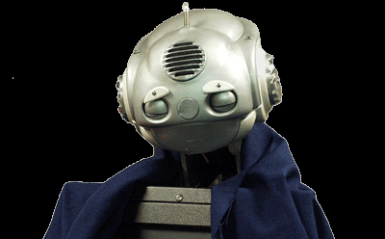
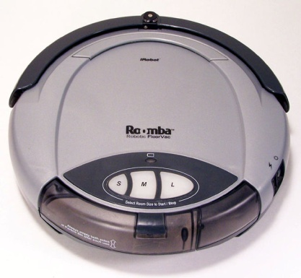
Robots Everywhere
Credit: Paro Robots U.S., Inc.
At home: Paro, therapeutic robotic seal
Credit: Carnegie Mellon University
Credit: Honda
At home/clinics: Nursebot, robotic assistance for the elderly
At work: Two ASIMOs working together in coordination to deliver refreshments
At home: iRobot Roomba vacuums your house

Slide 20
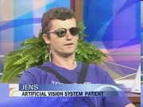
Assistive Technologies for Everyone
brain-computer interfaces of today
memex of tomorrow

Slide 21
What is Common to These Systems?
They have a computational core that interacts with the physical world.
Cyber-physical systems are engineered systems that require tight conjoining of and coordination between the computational (discrete) and the physical (continuous).
Trends for the future
Cyber-physical systems will be smarter and smarter.
More and more intelligence will be in software.

Slide 22
A (Flower) Model for Expediting Progress
Sectors
Industry Gov’t (e.g., military)
medical
aero
finance
Industry Gov’t Academia
Fundamental Research
auto
transportation
Academia Gov’t (NSF, NSA, NIH, DoD, …)
energy
civil
chemical
materials

Slide 23
Summary of Cross-Cuts

Slide 24
Numbers in Terms of Projects (not Proposals)
Expected 100-300, Received 642 Proposals!
$35M originally allotted
 | # Submitted | # Awarded | Success Rate | $M (ARRA)
Cyber-Physical Systems | 527 | 58 | 11.01% | 45 (15.75)
Data-Intensive Computing | 61 | 19 | 31.15% | 13.6(0)
Network Science and Eng'g | 121 | 30 | 24.79% | 23 (8)
Trustworthy Computing | 336 | 74 | 22.02% | 68.4(22.4)

Slide 25
CPS Luncheon on the Hill: July 9, 2009
Goal: Show off CISE
Audience: Senate and House staffers
250 underestimate attendees
71 Congressional staffers
Senator Reid and Dr. Bement attended, played with demos (lots of robots), and made remarks strong on science and research
Speakers: Jeannette Wing, Julian Goldman (Harvard, medical), Don Winter (Boeing, avionics)
http://www.nsf.gov/news/news_summ.jsp?cntn_id=115211

Slide 26
Data-Intensive Computing Infrastructure for CISE Community
Google + IBM partnership announced in February 2008
Access to 1600+ nodes, software and services (Hadoop, Tivoli, etc.)
Cluster Exploratory (CluE) seed program
April 23, 2008: Press release on CluE awards to 14 universities
http://www.nsf.gov/news/news_summ.jsp?cntn_id=114686&org=NSF&from=news
Oct 5-6, 2009: CluE PI meeting, Mountain View, CA
https://wiki.umiacs.umd.edu/ccc/index.php/CLuE_PI_Meeting_2009
HP + Intel + Yahoo! + UIUC cluster announced in July 2008
1000+ nodes
Bare machine, not just software (Hadoop) accessible
Hosted at UIUC, available to entire community
Microsoft partnership to provide Windows Azure platform
Announced February 4, 2010
Supplements, EAGERs, soliticitation shortly
Will engage OCI and other science and engineering directorates

Slide 27
Network Science and Engineering
NetSE Council Research Agenda, September 2009
http://www.cra.org/ccc/docs/NetSE-Research-Agenda.pdf
7th GENI Engineering Conference, March 16-18, 2010
Future Internet Architectures
Summit October 12-15, 2009
In response to External Review Committee of FIND
FIA program solicitation for 2-4 large-scale pilots, deadline April 22, 2010

Slide 28
Trustworthy Computing
Trustworthy = reliability, security, privacy, usability
Broadening and deepening scope of “Cyber Security”
Foundations of trustworthy
Models, logics, algorithms, metrics
E.g., Science of Security
Privacy
Usability
FY11 Request $70M
Increase reflected in Comprehensive National Cybersecurity Initiative (CNCI) total of $55.00M (+$15.00M over FY10)

Slide 29
Others
Joint with other directorates and offices
CISE + BIO + SBE + MPS: Computational Neuroscience (with NIH)
CISE + ENG: Cyber-Physical Systems, Multi-core (with SRC)
CISE + MPS: FODAVA (with DHS), MCS
CISE + OCI: DataNet
OCI + CISE + ENG + GEO + MPS: PetaApps
Creative IT (co-funding with other directorates)
Activities with other agencies, e.g., DARPA, DHS, IARPA, NGA, NIH, NSA
Partnerships with companies
Google+IBM, HP+Intel+Yahoo!, Microsoft: Data-Intensive Computing
SRC: Multi-core
Research infrastructure: CRI, MRI
…
Please see website www.cise.nsf.gov for full list.

Slide 30
New for FY10

Slide 31
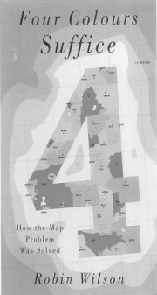
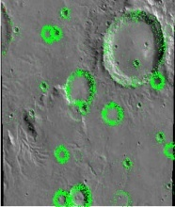
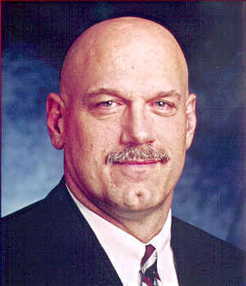
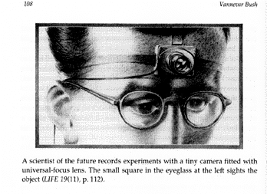
Clickworkers
Collaborative Filtering
Collaborative Intelligence
Collective Intelligence
Computer Assisted Proof
Crowdsourcing
eSociety
Genius in the Crowd
Human-Based Computation
Participatory Journalism
Pro-Am Collaboration
Recommender Systems
Reputation Systems
Social Commerce
Social Computing
Social Technology
Swarm Intelligence
Wikinomics
Wisdom of the Crowds
Socially Intelligent Computing

Slide 32
Socially Intelligent Computing: Computing BY and FOR Society
Sample Question: Can we understand the capabilities of humans and computers working in harmony, solving problems neither can solve alone?
Social-Computational Systems (SoCS) (pronounced “socks”)
Solicitation posted Wednesday, April 29
CISE + SBE: 6 CISE PDs and 5 SBE PDs
$15M
Deadline Sept. 21, 2009
147 proposals submitted (122 projects)
http://www.nsf.gov/funding/pgm_summ.jsp?pims_id=503406&org=CISE&from=home

Slide 33
Education and Workforce

Slide 34
Education Implications for K-12
Question and Challenge for the Computing Community:
What is an effective way of learning (teaching) computational thinking by (to) K-12?
- What concepts can students (educators) best learn (teach) when?
What is our analogy to numbers in K, algebra in 7, and calculus in 12?
- We uniquely also should ask how best to integrate The Computer with teaching the concepts.
Computer scientists are now working with educators and cognitive learning scientists to address these questions.

Slide 35
C.T. in Education: Community Efforts
FY09 Highlights
College Board: AP
10,000 x 10,000
“C” in STEM
ACM-Ed
Computing Community
CRA-E
CSTA
NSF
College Board
Rebooting
Computational Thinking
National Academies
workshops
CSTB “CT for Everyone” Steering Committee
Marcia Linn, Berkeley
Al Aho, Columbia
Brian Blake, Georgetown
Bob Constable, Cornell
Yasmin Kafai, U Penn
Janet Kolodner, Georgia Tech
Larry Snyder, U Washington
Uri Wilensky, Northwestern
K-12
BPC
CPATH
AP

Slide 36
Adding “C” to STEM
STEM = Science, Technology, Engineering, and Mathematics
Time is right.
Society needs more STEM-capable students and teachers.
The Administration understands the importance of STEM.
Hill Event to promote this vision
Wed, May 29, 2009 12:00 - 1:30 PM B339 Rayburn House Office Building
Computer Science Education Week
December 5-11, 2009
Designation by US House of Representatives

Slide 37
Computing Innovation Fellows (CIFellows)
Situation: Economic crisis for graduating Ph.D. students
Goal: Keep people in the academic pipeline
CISE awards CRA $15M for 100 fellows (60 this year, 40 next)
Tremendous response: 526 applicants, over 1300 mentors
Matching to ensure “cross flow” and diversity
60 from 43 distinct institutions going to 48 distinct institutions
40% women, 11% underrepresented minorities, 70% US or PR
Social experiment for our field
Where will the individuals be in six years?
Will their institutions be different?

Slide 38
Young Investigators
Graduate Research Fellowships (GRF)
$2.55M in FY11
Reflects doubling over past two year
CAREER program
$54.57M in FY11
7.1% increase over FY10

Slide 39
Working with the Administration and Other Agencies

Slide 40
Administration Interests
Broadband
“Unleashing Waves of Innovation” white paper
March 24 Served on NTIA Panel (oral remarks and Q&A) representing academia
$7.2B ARRA: Helping NTIA, RUS with Broadband Technologies Opportunity Program (BTOP)
National Economic Council weekly meetings
October 26 meeting with FCC
Wireless Telecommunications
Sept 24 OSTP request for academic input on spectrum policy
Cybersecurity
President’s 60-Day Cyber Space Policy Review
March 18 telecon with Melissa Hathaway
June 16 testimony to House Committee on Science and Technology Subcommittees on Technology and Innovation, and Research and Science Education
Comprehensive National Cybersecurity Initiative
$30M FY09
October 1 OSTP briefing
National Cyber Leap Year
August 17-19: “Game-Changing” Ideas
October 6 OSTP briefing
Cyber Learning (more later)
OSTP interest, NSB interest, CISE representation and ideas strong
Health IT (more later)

Slide 41
Looking Ahead to FY11 and Beyond in Computing

Slide 42
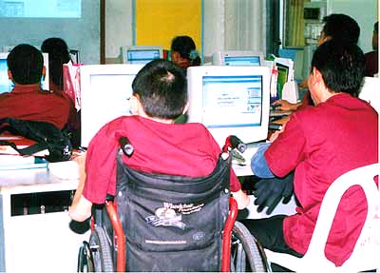
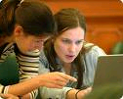
Drivers of Computing
7A’s
Anytime Anywhere
Affordable
Access to Anything by Anyone Authorized.
Society
Science
Technology
What is computable?
P = NP?
(How) can we build complex systems simply?
What is intelligence?
What is information?
J. Wing, “Five Deep Questions in Computing,” CACM January 2008

Slide 43
IT and Sustainability (Energy, Environment, Climate)
IT as part of the problem and IT as part of the solution
IT as a consumer of energy
2% (and growing) of world-wide energy use due to IT
IT as a helper, especially for the other 98%
Direct: reduce energy use, recycle, repurpose, …
Indirect: e-commerce, e-collaboration, telework -> reduction travel, …
Systemic: computational models of climate, species, … -> inform science and inform policy
Engages the entire CISE community
Modeling, simulation, algorithms, energy-aware computing, science of power management, sensors and sensor nets, intelligent decision-making
Energy: A new measure of algorithmic complexity and system performance, along with time and space
FY11 SEES agency-wide effort: $765.50M NSF, $29.36M CISE
CISE’s part of NSF’s FY10 Climate Research Initiative (CRI) and NSF’s FY Science, Engineering, and Education for Sustainability (SEES)
Notes:
Organization of Economic Co-Operation and Development (OECD)
SEES agency-wide effort: $765.50M NSF, $29.36M CISE

Slide 44
CyberLearning
Anytime, Anywhere Learning
Personalized Learning
(Cyber)Learning about (Cyber)Learning
Task Force on Innovation and Learning
- Chaired by Jeannette Wing, members from CISE, EHR, GEO, OCI, SBE - Informing NSF’s interests in CyberLearning
- Coordinating with NSB’s interest in a STEM-literate workforce
- Administration interest in K-12 STEM education
FY11 Cyberlearning Transforming Education (CTE) with EHR & SBE: $41.28M total, $15.00M CISE

Slide 45
Health IT
It’s more than electronic health records
It’s more than digitizing current data and processes
What are the computing research challenges such that we can transform the way in which healthcare is delivered in the future? Goal: patient-centered, individualized.
Modeling, decision making, discovery, visualization, summarization, data availability, smart sensing, telemetry, actuation for patient monitoring, robotics and vision for diagnosis and surgery, deployment (software integration), security and privacy, …
Discovery and Innovation in Health IT Workshop
October 29-20, 2009, San Francisco
Sponsored by NSF, NIST, ONC, NLM, and AHRQ
Working with ONC of HHS on SHARP (Health IT Research Centers)
ARRA Section 13202(b) – NITRD Strategic Plan for Health IT
CISE AD co-chairs NITRD
Working with ENG and SBE within NSF

Slide 46
Computer Science and Economics
Computer Science influencing Economics Economics influencing Computer Science
Automated mechanism design underlies electronic commerce, e.g., ad placement, on-line auctions, kidney exchange
Internet marketplace requires revisiting Nash equilibria model
Use intractability for voting schemes to circumvent impossibility results
Research Issues at the Interface of Computer Science and Economics Workshop
- Ithaca, September 3-4, 2009, sponsored by CISE
- Stellar line up of computer scientists and economists
- http://www.cis.cornell.edu/conferences_workshops/CSECON_09/

Slide 47
Computer Science and Biology
Gene sequencing and bioinformatics are a given
Trend now is looking at common principles between the two disciplines
Complex systems
Uncertainty of environment
Networked
Real-time adaptation
Fault-tolerant, resilient
Information systems
Programmed systems
Synthetic biology
First decade of CS+Bio was low-hanging fruit. Second decade will form deeper and closer connections.
CISE+BIO DCL will direct PIs to relevant programs

Slide 48
Thank You!

Slide 49
Credits
Copyrighted material used under Fair Use. If you are the copyright holder and believe your material has been used unfairly, or if you have any suggestions, feedback, or support, please contact: jsoleil@nsf.gov
Except where otherwise indicated, permission is granted to copy, distribute, and/or modify all images in this document under the terms of the GNU Free Documentation license, Version 1.2 or any later version published by the Free Software Foundation; with no Invariant Sections, no Front-Cover Texts, and no Back-Cover Texts. A copy of the license is included in the section entitled “GNU Free Documentation license” (http://commons.wikimedia.org/wiki/Commons:GNU_Free_Documentation_License)

