Slide 1
Pixels Everywhere
Media Tech and How it Changed the World
Pat Hanrahan
Department of Computer Science
Stanford University
Computing Research that Changed the World:
Reflections and Perspectives
Washington, DC
March 25, 2009

Slide 2
Transforming Media
From Analog to Digital

Slide 3
From Analog to Digital
Traditional media
Desktop publishing and printing
Digital audio, music and radio
Digital photography
Digital video, HDTV and movies
Notes:
Mention briefly the importance of media to our society

Slide 4
Timelines

Slide 5
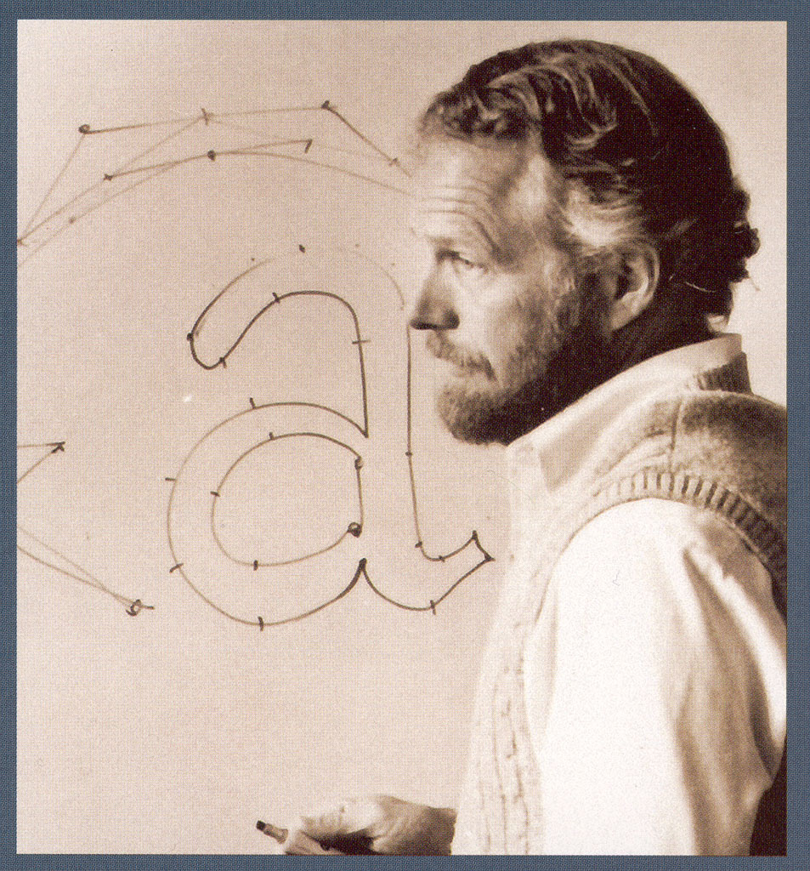
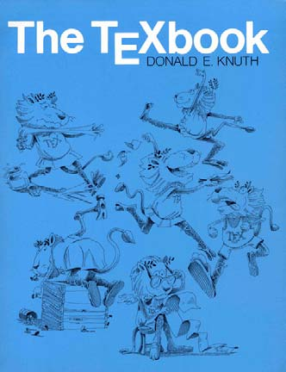
Print
Bezier curve (1962) for outlines
Bravo WYSIWYG text editor (1974)
First laser printer (1969)
Research
Products
1960
1970
1980
1990
2000
2010
Adobe Postscript (1982)
Apple Laserprinter (1985)
Aldus Pagemaker (1985)
Notes:
Bravo text editor, 1974 Lampson and Simonyi
Xerox laser printer, 1969, Starkweather
Interpress
Bezier curve
Adobe Postscript (1982)
Apple Laserprinter (1985)
Aldus Pagemaker (1985)
Google book project
The DTP market exploded in 1985 with the introduction in January of the Apple LaserWriter printer, and later in July with the introduction of PageMaker software from Aldus which rapidly became the DTP industry standard software.

Slide 6
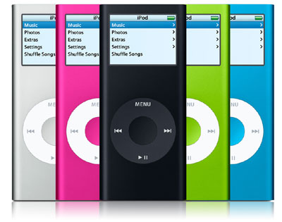
Audio
Reed-Solomon codes (1960)
FM Synthesis (1973)
Soundstream restoration
of Caruso recordings (1975)
MP3 standard (1991)
Research
Products
1960
1970
1980
1990
2000
2010
Optical CD (1982)
Apple iPod (2001)
Internet Radio (1990s)
Notes:
John Chowning FM synthesis 1973
http://www.ams.org/featurecolumn/archive/synthesizer.html
Reed-solomon codes in 1960
http://en.wikipedia.org/wiki/Reed%E2%80%93Solomon_error_correction
Soundstream founded in 1975 by Tom Stockham.
In 1976 Soundstream restored acoustic (pre-electronic) recordings of Enrico Caruso, using 'blind deconvolution' (Stockham 1971a). These were released by RCA as "Caruso - A Legendary Performer". In subsequent years Soundstream restored much of RCA's Caruso portfolio.
====
A Compact Disc (also known as a CD) is an optical disc used to store digital data, originally developed for storing digital audio. The CD, available on the market since October 1982, remains the standard physical medium for sale of commercial audio recordings to the present day.
Reed-Solomon codes on CDs?
====
MPEG-1 Audio Layer 3, more commonly referred to as MP3, is a digital audio encoding format using a form of lossy data compression. It is a common audio format for consumer audio storage, as well as a de facto standard encoding for the transfer and playback of music on digital audio players. MP3 is an audio-specific format that was designed by the Moving Picture Experts Group. The group was formed by several teams of engineers at Fraunhofer IIS in Erlangen, Germany, AT&T-Bell Labs in Murray Hill, NJ, USA, Thomson-Brandt, and CCETT as well as others. It was approved as an ISO/IEC standard in 1991.
1994 open source mp3 software; 1995 .mp3 filename extension
====
Digital satellite radio
Sirius founded?
XM founded?
====
Internet radio
RealNetworks 1995
====
iPod is a brand of portable media players designed and marketed by Apple Inc. and launched on October 23, 2001 (2001-10-23).

Slide 7
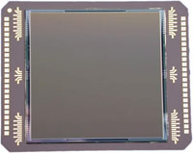
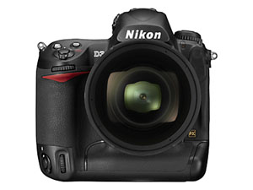
Photography
CCD imager (1969)
First digital paint system (1974)
CMOS imager (1993)
Discrete-cosine transform
Research
Products
1985
1990
1995
2000
2005
2010
Adobe Photoshop 1.0 (1990)
Nikon D1 digital SLR (1999)
flickr.com photosharing (2004)
Notes:
CCD, Boyle and smith
CMOS, Folsom, 1993
DCT
Adobe photoshop
Digital painting (Smith and Shoup)
Flickr
Kodak abandons film business

Slide 8
TV and Movies
NHK demo of analog HDTV (1969)
Motion-compensated image compression (-1993)
NSF STC Computer graphics and vis (1991-2002))
First feature-length computer-generated movie (1995)
Research
Products
1985
1990
1995
2000
2005
2010
Analog broadcast ends
(June 12, 2009)
ATSC standard ratified (1998)
TIVO time-shifted video (1999)
3D digital projectors
Notes:
NHK
Motion compensated image compression (MPEG)
ATSC standard; nth extension
Tivo time-shifted video (disks)
First full-length computer generated movies
Youtube
Digital projectors in theaters; 3D movies
Andy van Dam led STC center
Worked on first computer-generated movie – never thought it would be done in my lifetime

Slide 9
Media & Technology Interdependent
|Size| of media determines when it was transformed
Media poses science & technology problems
Storage
CD, DVD, Flash
Networking
Gigabyte networks, internet caching
Processing
GPUs, signal and media processors

Slide 10
Invention of New Media
Games
Multimedia computers and media servers
Networked graphics (flash) and the WWW
Sharing music (iTunes), photos (flickr, phototourism), videos (youtube)
Virtual worlds (Google Earth, Second Life, WoW)
Electronic books (Amazon Kindle)

Slide 11
Research Trends

Slide 12
Research Trends
Supercomputers on a chip
Reinventing photography and cameras
Building planetary-scale virtual worlds
New interaction devices

Slide 13
Modern GPU Architecture: 240 Cores
Host
Input Assembler
Setup & Rasterize
Vertex Thread Issue
Geom Thread Issue
Pixel Thread Issue
SP
SP
SP
SP
SP
SP
SP
SP
SP
SP
SP
SP
SP
SP
SP
L1
L1
L1
L1
L1
Thread Scheduler
TF
TF
TF
TF
TF
SP
SP
SP
SP
SP
SP
SP
SP
SP
SP
SP
SP
SP
SP
SP
L1
L1
L1
L1
L1
TF
TF
TF
TF
TF
L2
L2
L2
L2
L2
L2
L2
L2
Framebuffer
Framebuffer
Framebuffer
Framebuffer
Framebuffer
Framebuffer
Framebuffer
Framebuffer

Slide 14
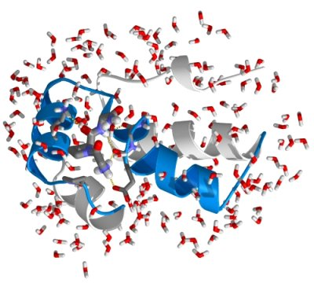
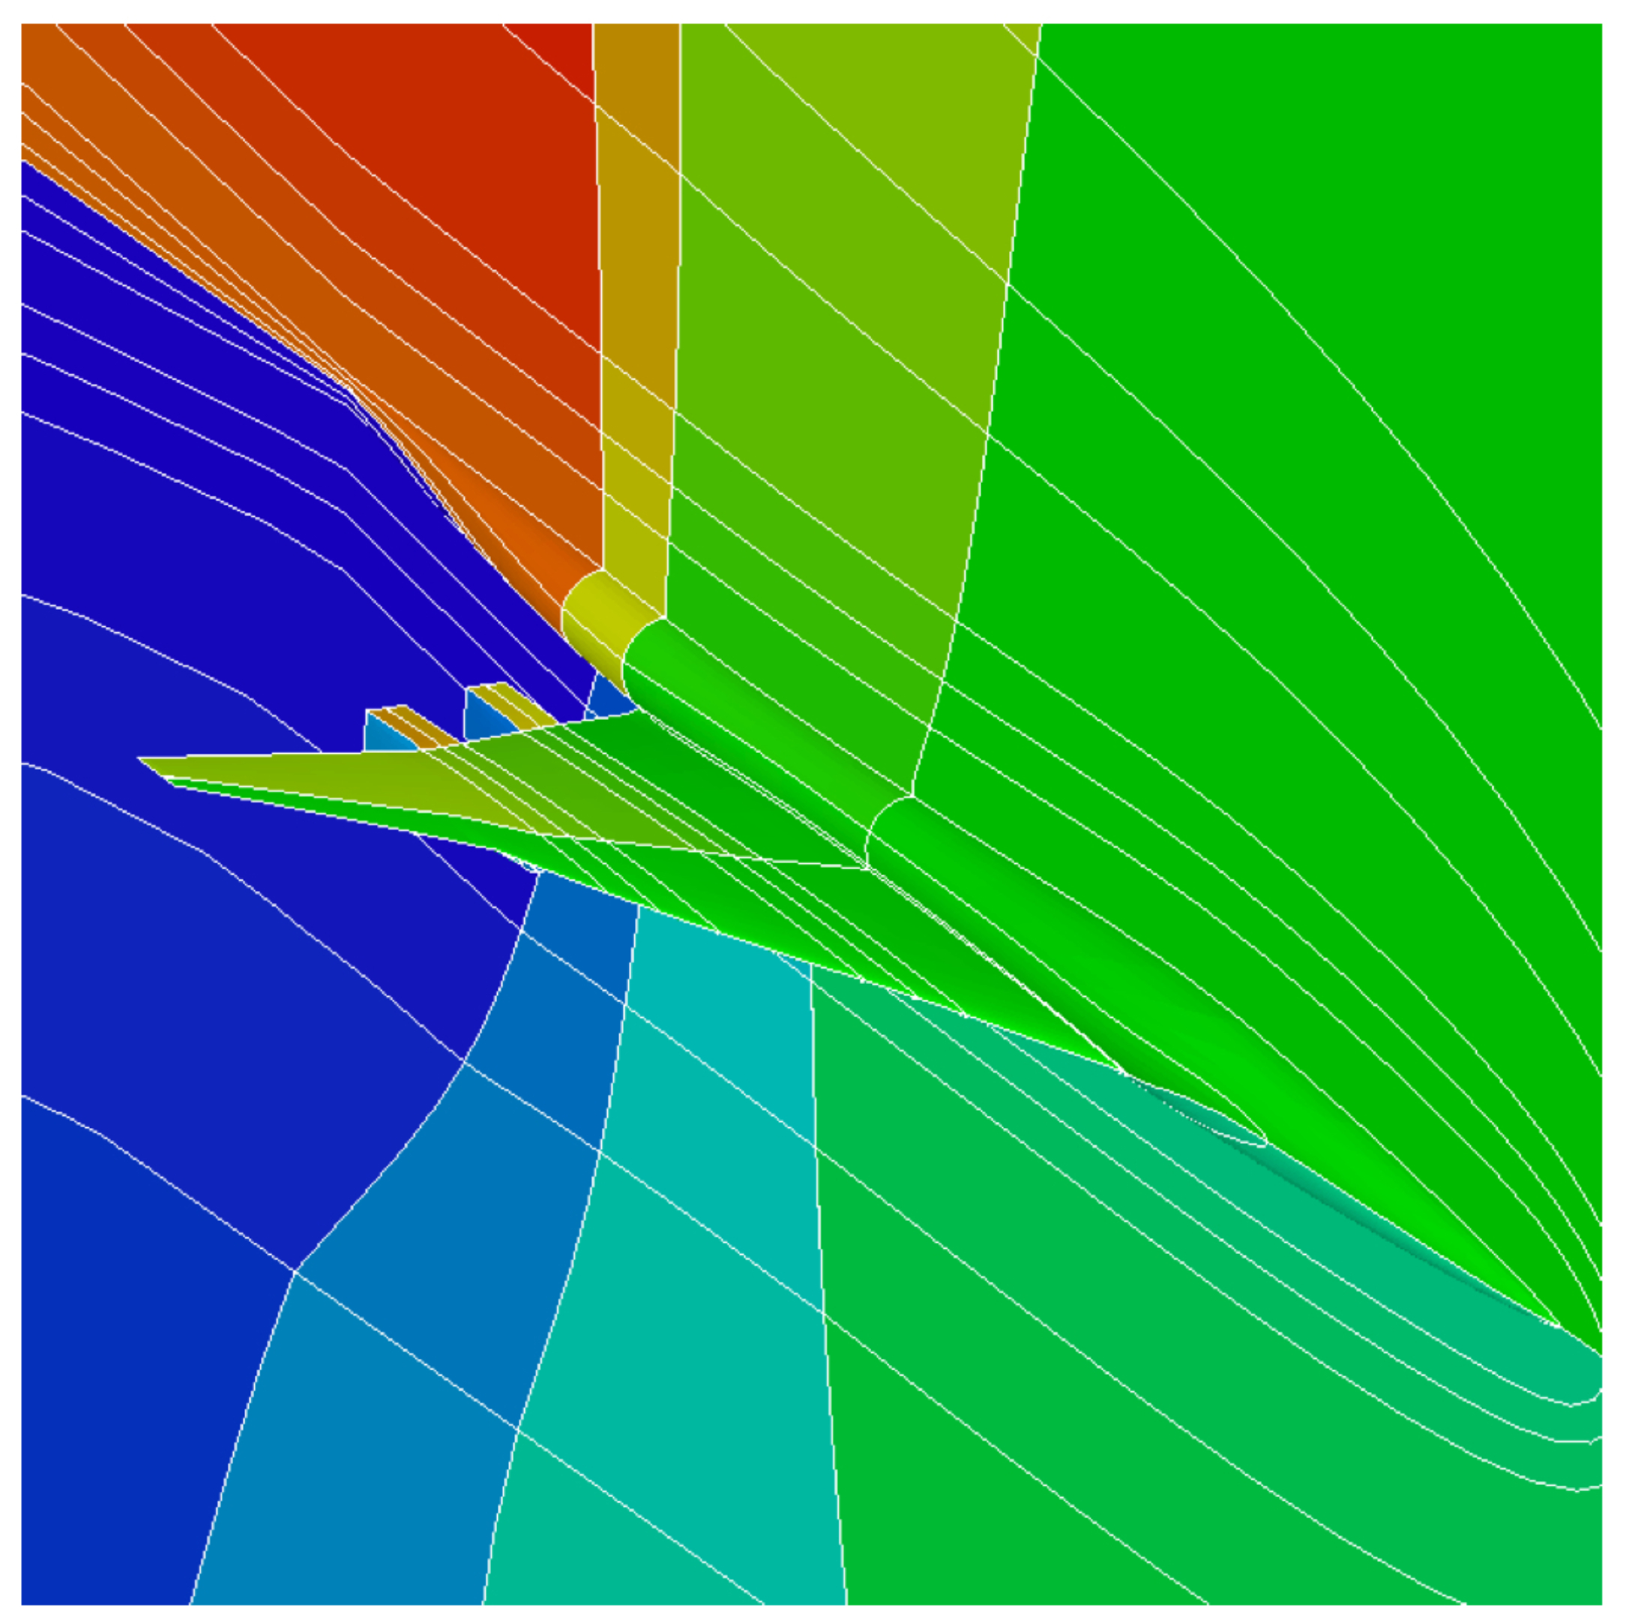
Challenges
Architectures that support 1000s of cores
Programming environments for 1000s of cores
Applications beyond graphics and media
One of the most pressing current problems in computer science
folding@home
Hypersonic vehicle

Slide 15
From Glass to Digital Lenses

Slide 16
From Glass to Digital Lenses
Notes:
1:15

Slide 17
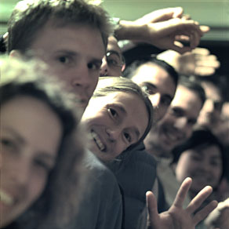
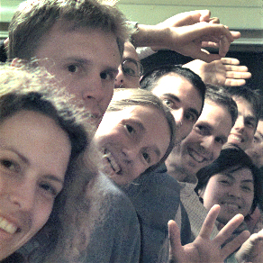
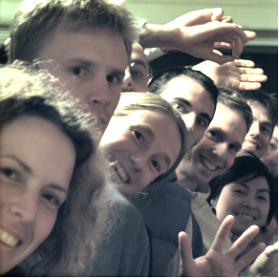
Focus in Software
conventional photograph, main lens at f / 4
conventional photograph, main lens at f / 22
light field, main lens at f / 4, after all-focus algorithm [Agarwala 2004]
Notes:
1:00
main lens at f/22
captured with light field camera and f/4 lens,
computed by extracting only the middle pixel of that image
would be the same image if no microlenses and larger pixels

Slide 18
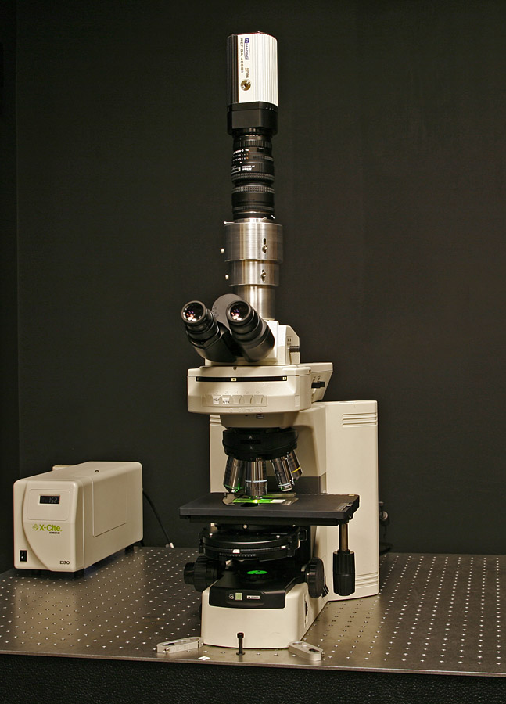
Light Field Microsope
sensor
eyepiece
intermediate
image plane
objective
specimen
Notes:
0.95NA
captures rays up to 70° away from the optical axis
no photographic lens comes close to this
this would be an f/0.5 lens !
2400 spots
limited by the wave optics of light
regardless of the number of pixels in our sensor

Slide 19
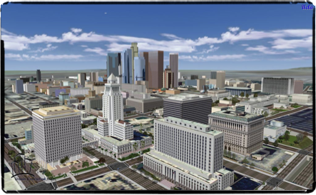
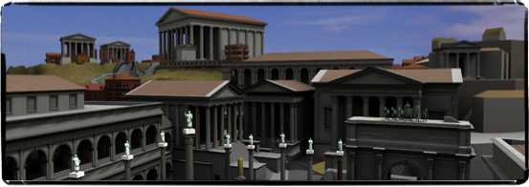
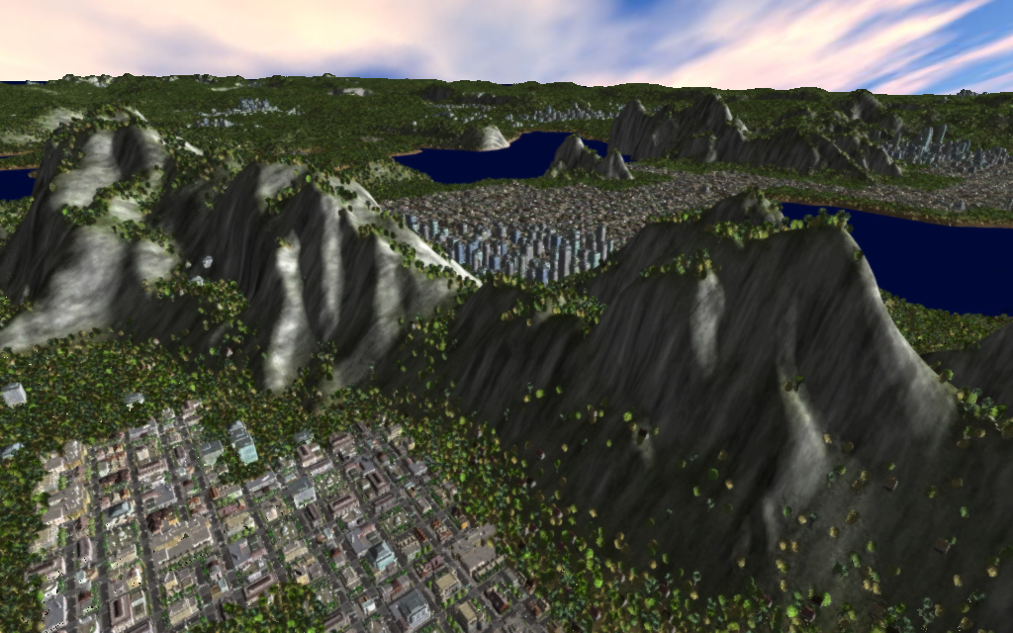
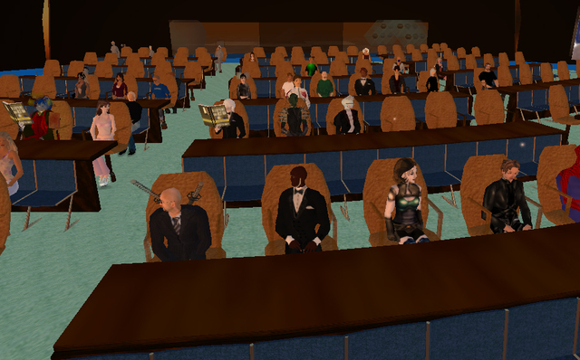
Virtual Worlds
Virtual LA (UCLA)
Rome Reborn (Virginia)
Meru (Stanford)
IBM Meeting in Second Life

Slide 20
Challenges
Planetary distributed object system (Web 10.0?)
Real-time response
Scalable (100B objects)
Robust and secure
Scalable simulation
Simulating physics across a world
Simulating evolving eco/social system
Laboratory for studying social science

Slide 21
Ocarina by Smule on the iPhone
Image courtesy of Ge Wang, Stanford Music Department

Slide 22
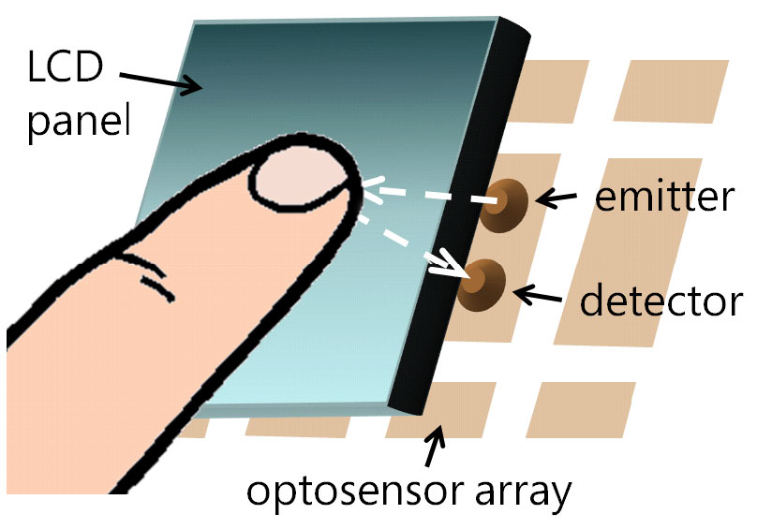
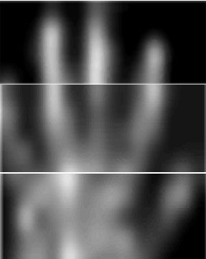
Multi-touch Display
Thinsight, Hodges et al. Microsoft
Notes:
3 panels
Each made of 7x5 arrangement of retro-reflective IR emitter-detectors
10 mm pitch
Total size is 150mm x 70 mm

