Slide 1
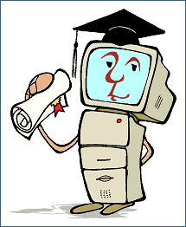
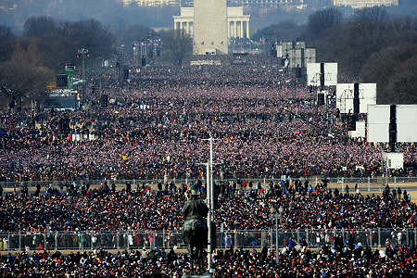
Learning
to improve our lives
Daphne Koller
Stanford University

Slide 2
Computers Can Learn?
Learned to get desired input/output mapping
Parameters
Program
Input
Output
Computers can learn to predict
Computers can learn to act

Slide 3
Many, many, many applications
Speech recognition
Fraud detection
Intrusion detection into computer systems
Image search
Activity recognition in video surveillance
Autonomous driving (DARPA Grand Challenge)
Early epidemic detection
Cancer subtype classification
Uncovering basic biological mechanisms
….

Slide 4
Example: Spam Filtering
Spam email:
Comprises 85-95% of email traffic
Cost US organizations > $13 billion in 2007
Spammers are constantly adapting
⇒ hand-constructed systems bound to fail

Slide 5
Learning to Detect Spam
Learned to optimize prediction quality
Increase parameters for words appearing in spam email
Decrease parameters for words appearing in good email
Can learn in advance
Online learning adapts to changing trends
And to personalize to a user’s preferences
Collaborative learning allows learning from other people’s data
Features
Parameters
pharmacy
unique offer
doctor
! (x 2)
…
“spamness”
= 18.3
5
7
0.5
1
…
Program
Input
Output
Notes:
How did this program work? Let’s first talk about how a learned program operates. It takes an instance, in this case, a configuration for a checkers board. The program analyzed the board, and figured out how “good” it was, where a good board is one that was more likely to lead to a win. This gave the program a way of evaluating different boards, and allowed it to select moves that produced better boards. The key is this evaluation function, and how it’s trained. First, we need to describe the checkers board in a way that makes clear to the computer what are the important aspects. In Samuel’s case, he described each board in terms of 38 “features”, such as the number of pieces, … Each of those features had a weight, which told the computer how important each of them was. These parameters were what the program learned by playing.

Slide 6
Harder: Machine Translation
Input can’t be viewed as a “bag” of words
Output is not a simple decision (spam / not spam) but a complex sentence
Machine translation using human-constructed translation rules floundered for decades
The spirit is willing but the flesh is weak.
English to Russian and back
The vodka is good but the meat is rotten.
Notes:
A very different application (not really perception) is machine translation. Again, hand-constructed systems, this time based on sophisticated linguistic rules, failed. Basically, they worked well on the sentences that the system designers had in mind when designing the system, but not on the vast majority of sentences out there. One early example occurred in English-Russian translation (a hot area right after the Sputnik launch).

Slide 7
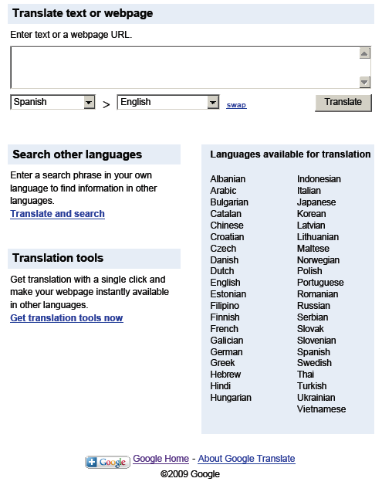
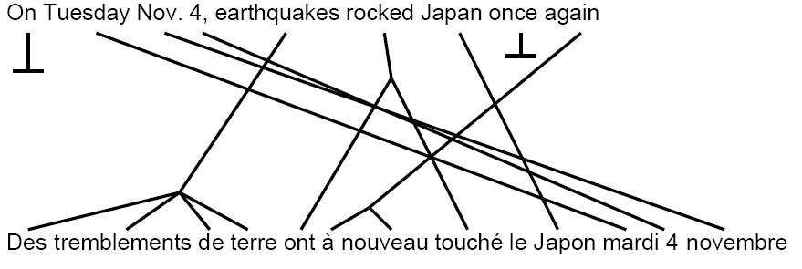
Harder: Machine Translation
ML-based machine translation systems
Use matched text in two languages to learn matching between words or phrases
text in target language to learn what “good” text is like
Thanks to: Mehran Sahami

Slide 8
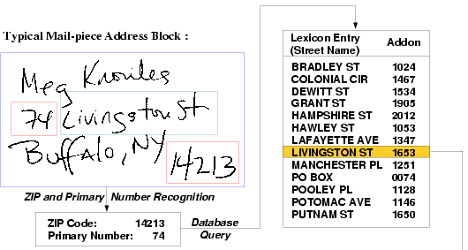
Perception
Impossible using hand-coded rules
Example: Automated handwriting recognition
Deployed at all 250+ Postal Distribution Centers
25 billion+ letters processed annually
> 92% automated processing
Hundreds of millions of $ saved each year
Thanks to: Venu Govindaraju
Notes:
Perception is a task where top researchers have spent hundreds of thousands of hours trying to engineer systems using manually-constructed software, and have failed time and time again. One example is handwriting recognition. Why is this hard? First, it’s hard even for isolated digits. Second, we actually have a much more complicated input/output functionality. The output is not an isolated digit but a string of letters all mushed together. Nevertheless, a well-designed machine learning system now screens and processes over 92% of our mail, saving the US tax payer hundreds of millions of dollars every year. Similar systems can read and transcribe arabic, with obvious implications to national security.

Slide 9
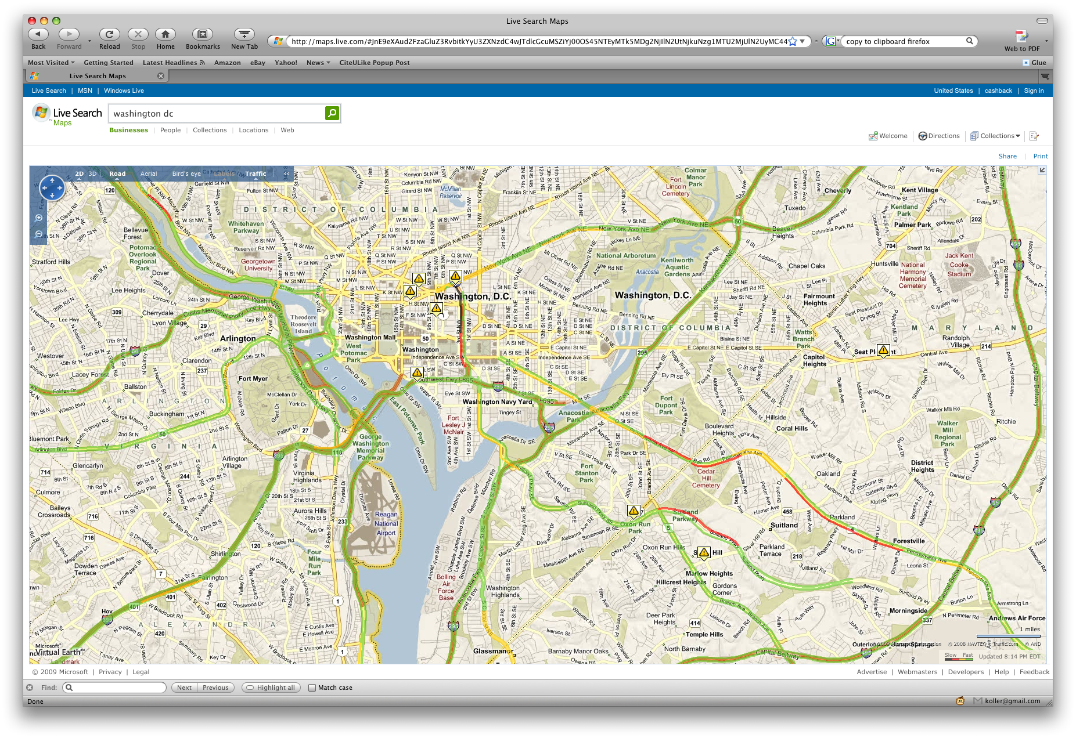
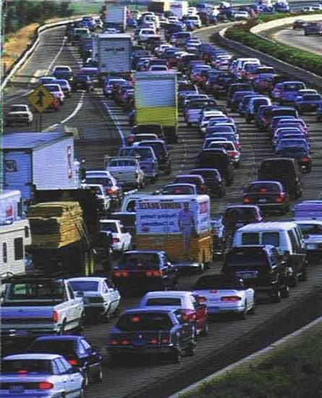
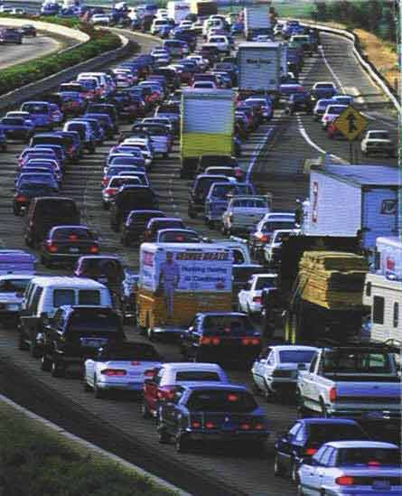
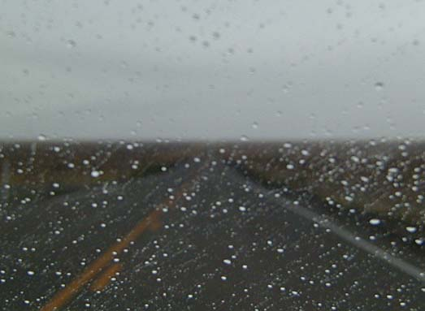
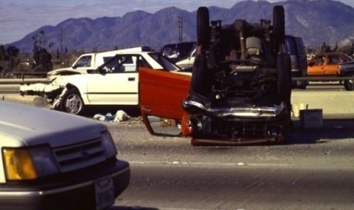
Multi-Sensor Integration: Traffic
Trained on historical data
Learn to predict current & future road speed, including on unmeasured roads
Dynamic route optimization
Multiple views
on traffic
Weather
LearnedProgram
Incident reports
I95 corridor experiment: accurate to ±5 MPH in 85% of cases
Fielded in 72 cities
Thanks to: Eric Horvitz
Notes:
So far, we have focused on perception from a single source. There are also many cases where we have data streaming in from multiple sensors and information sources, often very heterogeneous in nature. Machine learning provides us with the tools to integrate those different sensors into a coherent picture. For example, a recently fielded traffic system.

Slide 10
Controlling Complex Systems
Thanks to: Andrew Ng
Notes:
So far, we have looked at systems that have a simple input/output functionality (although with complicated inputs and outputs). What about systems that need to do something, like Samuel’s checkers playing program?

Slide 11
Controlling Complex Systems
Learning by emulating a human (apprenticeship)
… and by adapting to experience
Adjust parameters to reward good behavior
Thanks to: Andrew Ng
Notes:
So far, we have looked at systems that have a simple input/output functionality (although with complicated inputs and outputs). What about systems that need to do something, like Samuel’s checkers playing program?

Slide 12
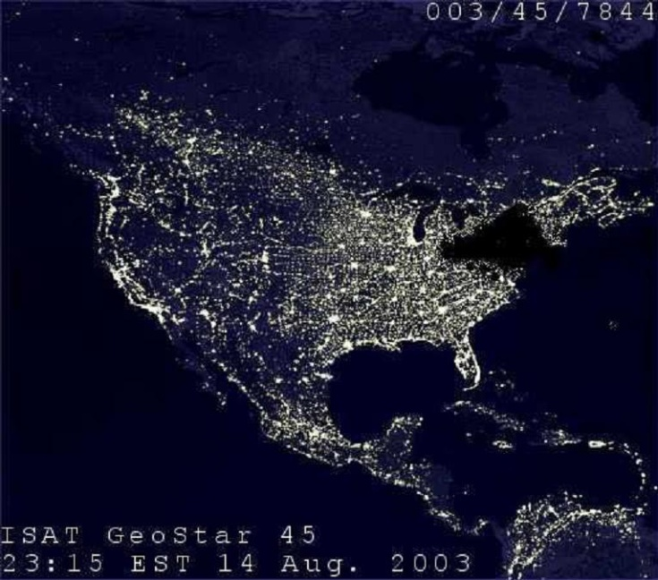
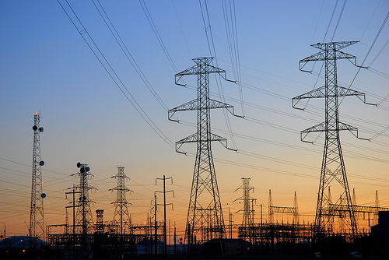
Future: Smart Power Grid
Key problem: Get (clean) energy from where it’s produced to where it’s needed on limited grid
Solution: Learning
Perception: predicting current and future demands
Control: Make robust and efficient routing decisions

Slide 13
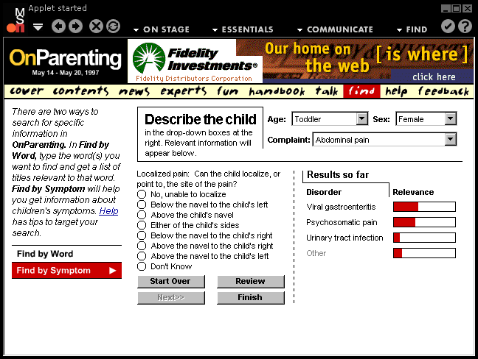
Medical Diagnosis
Improve quality of diagnosis:
Computer diagnosis systems outperform most doctors
Allow triage by less-experienced people
Thanks to: Eric Horvitz
Notes:
Talking about areas of national priority, another one is health care, with its ever-increasing costs. There are numerous potential applications of machine learning technology to medical care. One that has existed for a while was medical diagnosis, but was never fielded due to numerous reasons, most obviously the lack of electronic medical information. Here there are experiments that clearly demonstrate that a computer diagnostic system can diagnose better than most doctors, and certainly better than less experienced people. One example is a system that helped parents diagnose childhood ailments. Here, a computer model related predisposing factors, diseases, and symptoms, allowing the system ask the parents informative questions and help them diagnose the child. A more complicated model was designed to help expert physicians diagnose a larger range of internal diseases.

Slide 14
Medical Intervention
Patient-specific automatic detection of epilepsy seizures from EEG for real-time intervention
Response latency (sec)
Generic approach
Per-patient learned model
patients
Seizure Onset
Thanks to: John Guttag
Notes:
Many other applications exist. Constant monitoring of patients is an important setting where manual solutions are simply infeasible. One system, recently tested on real patients, monitors for oncoming epileptic seizures and intervenes immediately to stop them or reduce their severity. Other applications also exist, and are particularly relevant with the aging population. Other applications include a system that learns to recognize “standard of care” and detects treatments that do not meet the learned standard. Finally, there has been a lot of talk about evidence-based medicine. Here, we hope to learn which treatments are effective. But as described, “effective” is for the general population, and we know that response to treatment is a highly individual thing, which can depend on our age, gender, individual characteristics, genetic makeup, other diseases, and more. This type of detailed case analysis is far too much for a human to deal with, but is bread and butter for machine learning.

Slide 15
Medical Intervention
Patient-specific automatic detection of epilepsy seizures from EEG for real-time intervention
Reduce frequency of medical errors
Learn “standard of care” and detect anomalies
Reduce enormous cost: financial and human life
Home-based systems for tracking of chronic patients for early prediction of complications
Reduce pain, suffering, and cost of hospitalization
Notes:
Many other applications exist. Constant monitoring of patients is an important setting where manual solutions are simply infeasible. One system, recently tested on real patients, monitors for oncoming epileptic seizures and intervenes immediately to stop them or reduce their severity. Other applications also exist, and are particularly relevant with the aging population. Other applications include a system that learns to recognize “standard of care” and detects treatments that do not meet the learned standard. Finally, there has been a lot of talk about evidence-based medicine. Here, we hope to learn which treatments are effective. But as described, “effective” is for the general population, and we know that response to treatment is a highly individual thing, which can depend on our age, gender, individual characteristics, genetic makeup, other diseases, and more. This type of detailed case analysis is far too much for a human to deal with, but is bread and butter for machine learning.

Slide 16
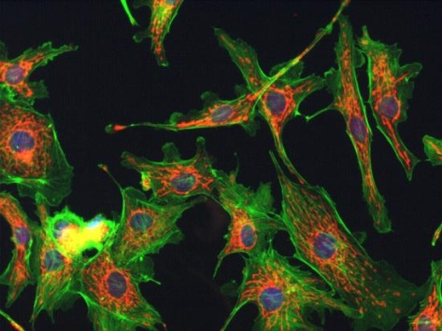
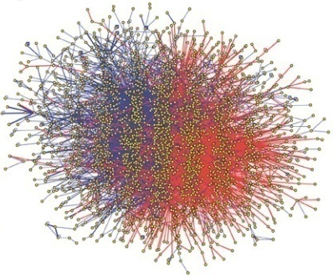
Scientific Discovery
New technologies revolutionize biology
High-throughput sequencing
Gene expression
Protein-protein interactions
Proteomics
Cellular microscopy
….
But how do these help understand & cure disease?

Slide 17
Our Genes Determine Who We Are
Humans differ in 0.1% of their DNA
These differences determine who we are, what diseases we’ll get, and which cures will work for us
Which differences matter?
…ACTCGGTAGGCATAAATTCGGCCCGGTCAGATTCCATACAGTTTGTACCATGG…
…ACTCGGTGGGCATAAATTCGGCCCGGTCAGATTCCATACAGTTTGTTCCATGG…
…ACTCGGTAGGCATAAATTCGGCCCGGTCAGATTCCATACAGTTTGTACCATGG…
:
…ACTCGGTGGGCATAAATTCTGCCCGGTCAGATTCCATCCAGTTTGTACCATGG…
…ACTCGGTGGGCATAAATTCTGCCCGGTCAGATTCCATACAGTTTGTTCCATGG…
Diabetes patients
…ACTCGGTGGGCATAAATTCGGCCCGGTCAGATTCCATCCAGTTTGTTCCATGG…
…ACTCGGTGGGCATAAATTCGGCCCGGTCAGATTCCATCCAGTTTGTACCATGG…
…ACTCGGTGGGCATAAATTCGGCCCGGTCAGATTCCATCCAGTTTGTACCATGG…
: :
…ACTCGGTGGGCATAAATTCGGCCCGGTCAGATTCCATCCAGTTTGTACCATGG…
…ACTCGGTGGGCATAAATTCTGCCCGGTCAGATTCCATCCAGTTTGTTCCATGG…
Healthy
individuals

Slide 18
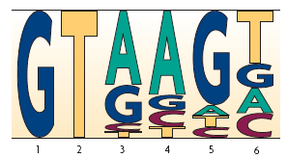
Where Are the Genes?
Only 5% of DNA appears to play functional role
To understand which genetic changes matter, we need to find the functional pieces, such as genes
Train model using known genes
Learn what DNA sequences characterize them
Machine learning critical to gene finding
Thanks to: Michael Brent

Slide 19
Future: Smart Healthcare
Evidence-based medicine: Learn what works
… at personalized level: What works for me
Learn mapping from individual genotype and other factors to disease risk and drug suitability

Slide 20
Machine Learning = Computing on Steroids
ML core technology for prediction and decision
Makes possible applications where other methods simply don’t work
Perception
Personalization
Dynamic adaptation
Can improve almost any application
A little bit of learning goes a long way
Challenging
Application
Machine
Learning
Data

