Slide 1
Workshops on Advancing Computer Architecture Research (ACAR)
Summary Slides
Organizers:
Josep Torrellas (University of Illinois)
Mark Oskin (University of Washington)
Contributors: Mark Oskin, Josep Torrellas, Sarita Adve, George Almasi, Luis Ceze, Almadena Chtchelkanova,
Chita Das, John Davis, Sandhya Dwarkadas, Lieven Eeckhout, Bill Feiereisen, William Harrod, Daniel Jimenez,
Mark Hill, Jon Hiller, Sampath Kannan, Krishna Kant, Martha Kim, Christos Kozyrakis, James Larus,
Margaret Martonosi, Richard Murphy, Onur Mutlu, Satish Narayanasamy, Kunle Olukotun, Yale Patt,
Andrew Putnam, Tim Sherwood, Anand Sivasubramaniam, Kevin Skadron, James Smith, Karin Strauss,
Steven Swanson, Dean Tullsen, David Wood, Craig Zilles
Sponsored by Computing Community Consortium (CCC) Computing Research Association (CRA)
Held on February 22-23, 2010 in San Diego and on September 20-21, 2010 in Seattle
http://www.cra.org/ccc/acar.php

Slide 2
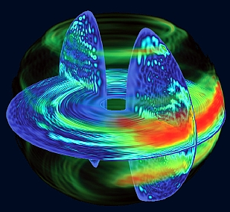
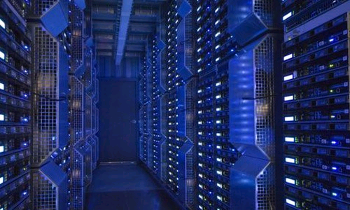
Extreme Scale Computing
Energy and power consumption limitations require complete rethinking of computer architecture
Cloud computing:
Provide utility computing
Data centers will be used by billions of cost-conscious users and run applications written by many developers.
High-performance computing:
Revolutionize experimental computing techniques
Goals:
Design machines that are 1000x more energy-efficient for the same performance and physical footprint
Consume only 20pJ/operation
Reduce the cost of data-center infrastructure to 1 Watt and $1 per month for the typical user
Enable individual programs to scale from a single-node system with tens of users to a full data-center deployment with millions of nodes and billions of users
Wealth of research to do:
Chip and node architecture
Memory and storage
Runtime and OS
Highly transformative: Extreme scale computing can provide cheap utility computing for billions of citizens
Energy and power consumption is the key limiter to progress

Slide 3
Architectures for Programmability
The continued performance scaling of computer systems now requires extensive software and hardware changes to exploit parallelism
Attaining a high-performance, correct 1000-core chip that is also highly programmable is a major challenge
Goals:
Programming for parallel architectures should be as easy as it is now for sequential architectures
Maintain Moore’s Law for performance (double the speed-up every 2 years)
Eliminate concurrency bugs
Wealth of research to do:
Programming models and domain-specific languages
Correctness
Introspection
Scalable memory and communication fabric
Resource management
Highly transformative: Enabling programming for the masses of programmers
Historically, performance increases came without asking for significant software changes. However, performance scaling now requires extensive software and hardware changes to exploit parallelism

Slide 4
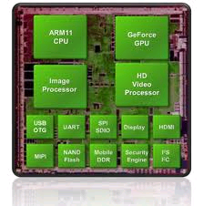
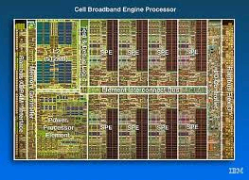
Specialized Architectures and Heterogeneity
HW/SW specialization eliminates inefficiencies and overheads that come with the flexibility of general-purpose systems
Want to develop the technologies necessary to deliver "turn-key" specialized computing systems quickly and economically
Goals:
Design specialized architectures that deliver up to 10,000x speed-up for particular applications at an affordable cost
Manufacturing costs should be no greater than they are for conventional commodity computing systems.
Methodology should scale across form factors
Specialized system should integrate seamlessly into existing software systems
Wealth of research to do:
Heterogeneous designs
Leverage existing reconfigurable designs with dynamic reconfigurability
Identification of the correct software abstractions
Highly transformative: Obtain orders of magnitude improvements in performance, performance per Watt, and performance per dollar.
The ultimate goal is a fully automated generation of application-specific hardware for each program

Slide 5
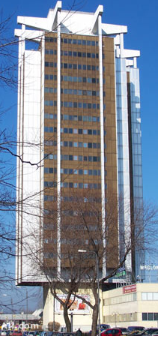
The End of the Road for Conventional Instruction Sets
The foundation of computing needs revisiting
The biggest problems in computing (security, scalability, programmability, reliability) are hamstrung by architectures built for completely different problems
Current hardware abstractions developed 30-50 years ago
Technology constraints very different today: abundance vs. scarcity; battery power-constrained vs. build-your-own power-plant;
Instruction granularity forces processors to view applications through a narrow window
Obfuscates concurrency, intent, and knowledge the compiler/runtime/application writer knew
Revisit fundamental assumptions of computer architecture:
Instruction-by-instruction Execution
Memory being typeless and monolithic
Virtual memory as only means of security and isolation
Industry will not invest in such fundamental research.
Highly transformative: rethinking the fundamental assumptions about ISA can unlock the solutions of many important challenges in modern systems, among them: security, reliability, manageability, energy consumption, and possibly even performance.
Modern systems are skyscapers built on the ISA foundation of a bungalow

Slide 6
Secure, Reliable, and Predictable from the Hardware Up
Current architectures are fragile
do not fail gracefully, poor isolation mechanisms
unsecured by default; impossible to truly keep a secret (information leaks everywhere)
unpredictable and unspecified behavior (non-deterministic actions lead to bugs and frustration)
Goal: machines worthy of the trust we place in them
Reliability: verifiably correct in the face of faults and errors and software bugs
Security and privacy: new hardware foundations to support information containment, privacy, cryptography, and self-monitoring
Programmable & predictable: provide users and developers the hardware/software tools they need to understand a program’s behavior and performance
Wealth of research to do:
Strong containment: provable assurance about information leakage
Mutually distrustful parties: user need not trust the operating environment; environment need not trust the users
Trustworthy systems today cost $10,000 / line of code because they must be built on a shaky foundation. Typical systems cost $10/loc. A 2 orders of magnitude reduction in cost will transform the set of things we can trust machines to do. However, it will require fundamentally new architectures and ISAs to close gap.
The foundation of computing is breaking apart, and malicious parties exploit this fact for their gain. Without a serious commitment to science and engineering on this front, the losses to our economy and safety will only continue to grow

Slide 7
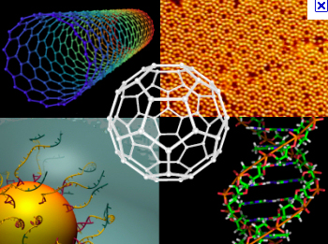
Exploiting Emerging Technologies
Emerging technologies offer orders of magnitude improvement for challenging architectural design aspects; e.g. on-die light channels.
Researching the architectural use-cases and implementation details early, engineering research brings science to market quicker and helps steer scientific inquiry.
Goal: play a useful role in shaping the directions and providing solutions for problems in emerging technologies, including: quantum, synthetic biology, PCM, 3D stacking, photonics, nanotubes, etc.
Transformative and high-risk: not all new technologies will be successful. Architecture research increases the likelihood of success, however, and some technologies can provide substantive leaps in performance and efficiency over CMOS.
Architecture research enables new technologies to enter the market quicker by identifying use cases and implementation challenges early.

